Slide 1
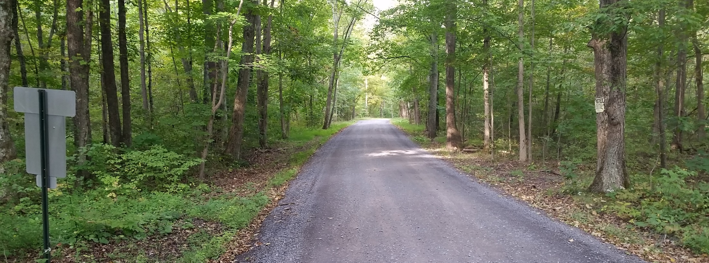
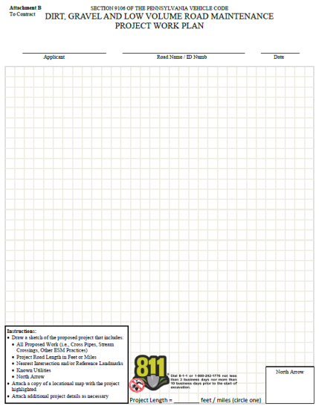
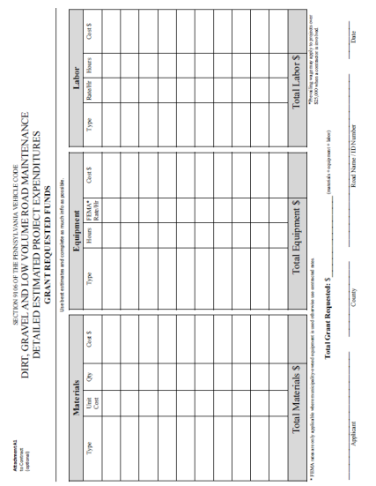
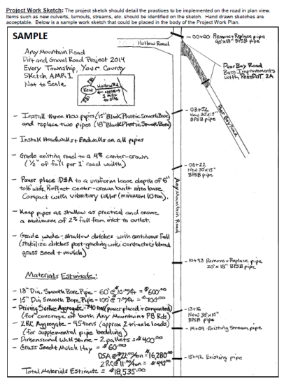
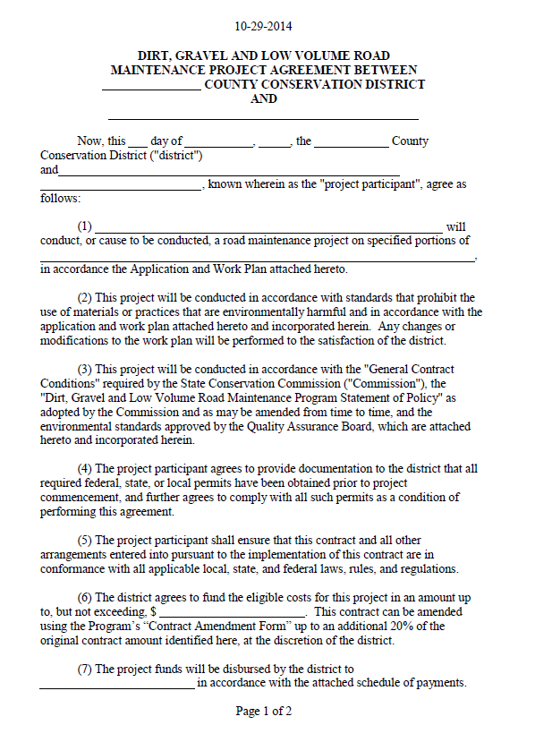
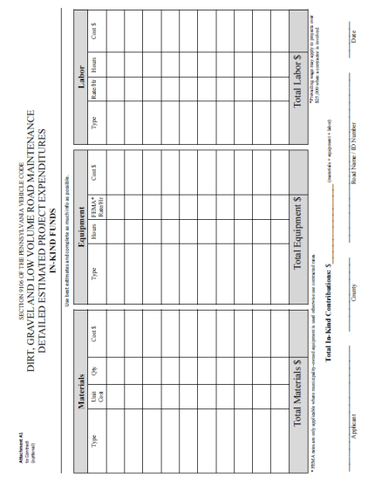
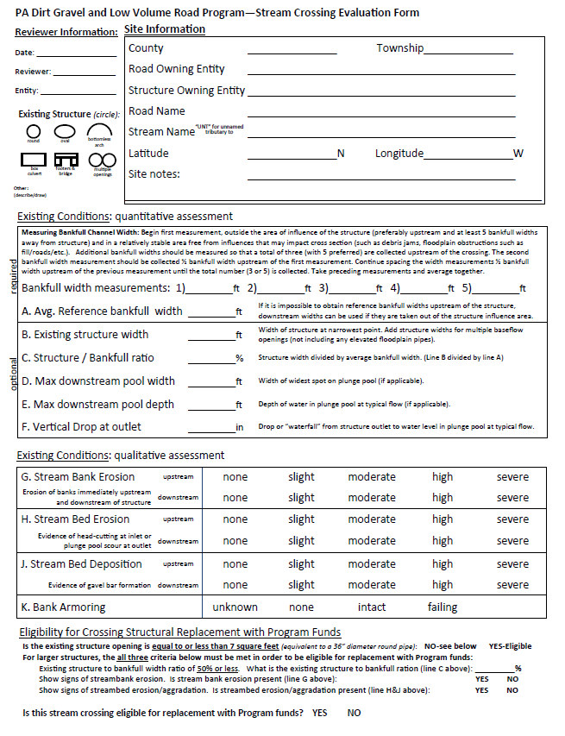
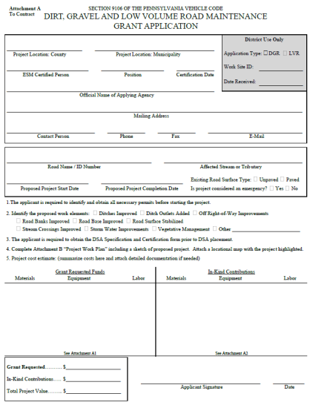
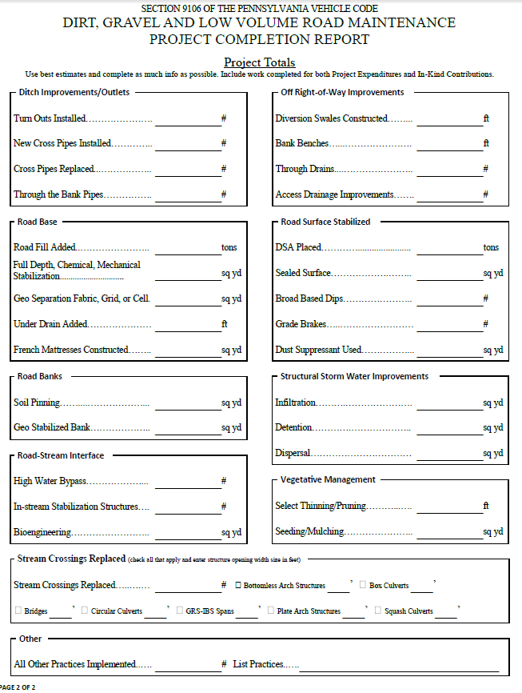
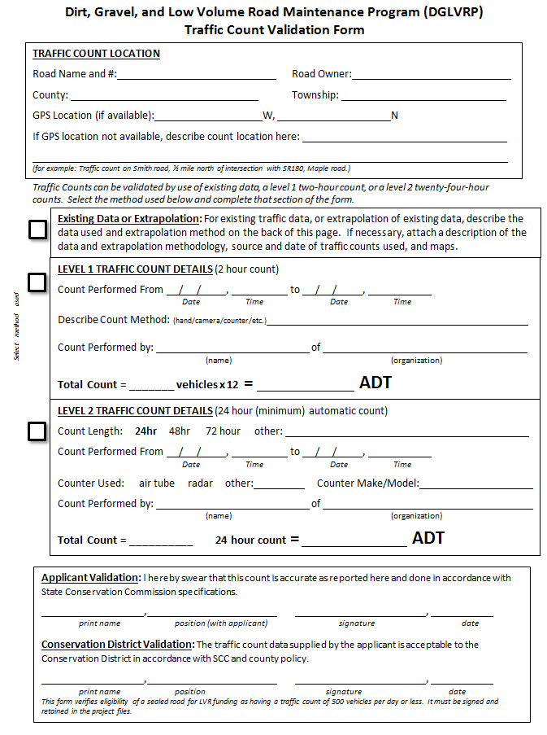
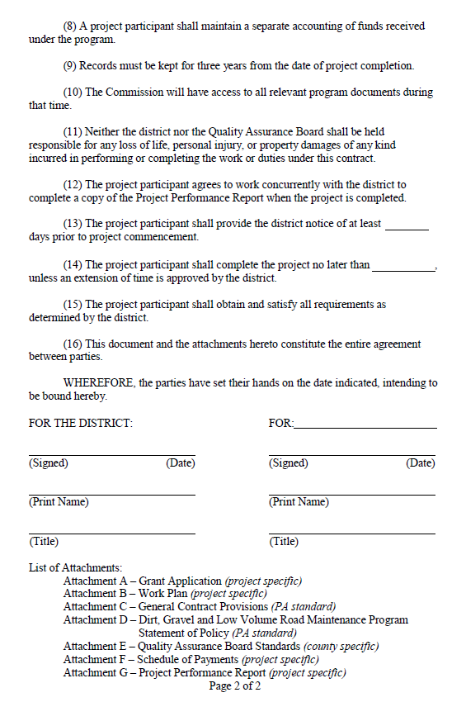
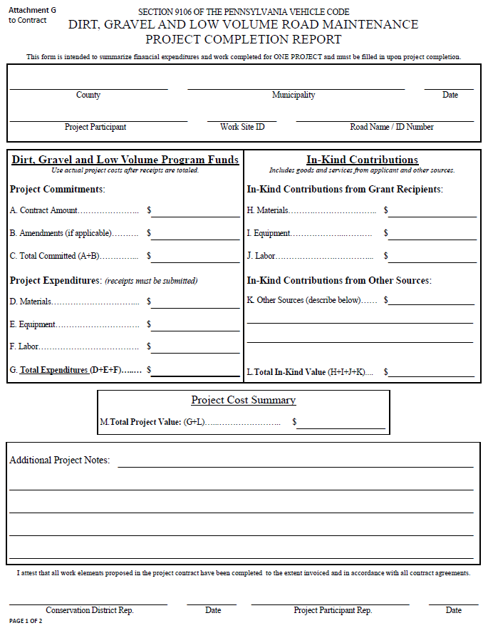
Dirt, Gravel, and Low Volume Road Maintenance Program
Administrative Training
Mar 2015

Slide 2
Administrative Training
Introduction
Roy Richardson
  PROGRAM Coordinator
  State Conservation Commission
  Pa Department of Agriculture
  rrichardso@pa.gov
  717-787-2013
Steve Bloser
  CENTER Director
  PSU Center for Dirt and Gravel Roads
  smb201@psu.edu
  814-865-5355

Slide 3
Administrative Training
Introduction
Goals today:
Provide guidance for Districts to run their Program.
Clear up “grey areas” in existing Program.
Outline new topics.

Slide 4
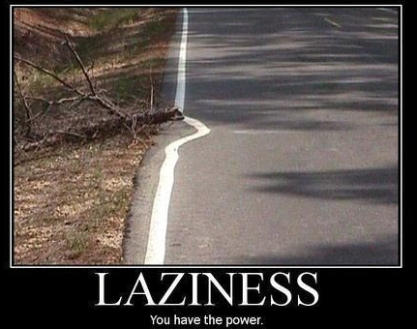
Funny Slide
http://funnyasduck.net/wp-content/uploads/2013/05/funny-road-lines-laziness-round-branch-pics.jpg

Slide 5
Administrative Training
Introduction
Program Fundamentals
Program values and structure are unchanged
  Focus on environmental benefits
  Local control
    Quality Assurance Boards at County
    State guidance and local policies
  Application and Grant Process

Slide 6
Administrative Training
Introduction
What do we mean by “Local Control”?

Slide 7
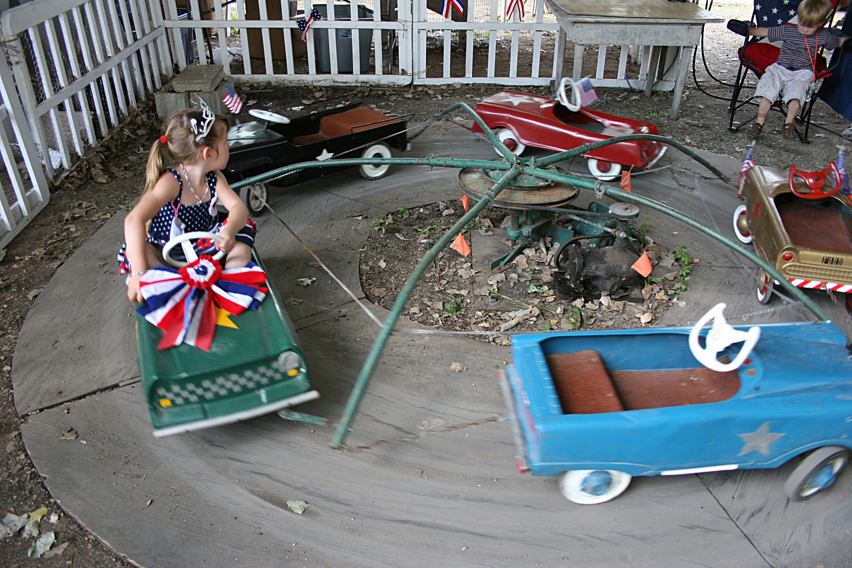
Administrative Training
Introduction
What do we mean by “Local Control”?
0% Local Control
Administrative Training

Slide 8

Administrative Training
Introduction
What do we mean by “Local Control”?
100% Local Control

Slide 9
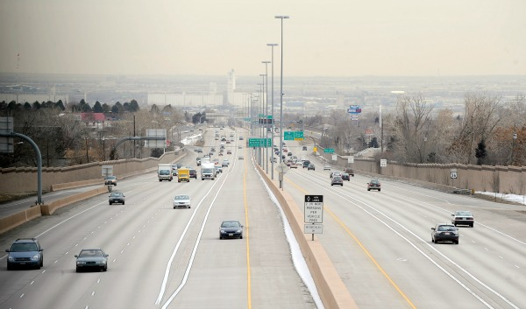
Administrative Training
Introduction
What do we mean by “Local Control”?
Effective local control
“lanes and guiderails”

Slide 10

Administrative Training
Introduction
Overall balancing act
Need for Increased Accountability
Simplicity and Local Control
D&G

Slide 11
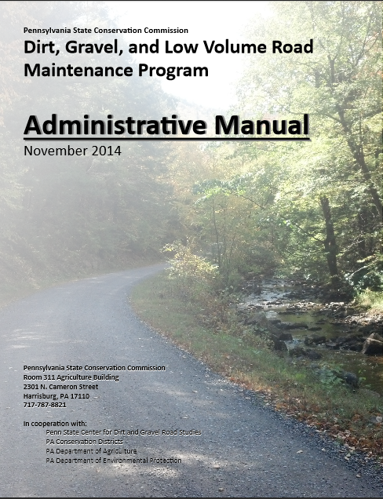
Administrative Manual
Introduction
DG&LVR Administrative Manual
Approved by SCC 11/12/14
Introduction
SCC Role
Conservation District Role
Quality Assurance Board Role
Applicant Role
Center for Dirt and Gravel Roads
Additional Policies
Permits and Other Requirements
Appendices
Available online.
Hard Copies being printed for CDs.
Training Follows Manual!

Slide 12
Administrative Manual
Introduction
DG&LVR Administrative Manual
Approved by SCC 11/12/14
Introduction
SCC Role
Conservation District Role
Quality Assurance Board Role
Applicant Role
Center for Dirt and Gravel Roads
Additional Policies
Permits and Other Requirements
Appendices
Available online.
Hard Copies being printed for CDs.
Introduction
4-page “Abstract” of the Program and the rest of the manual.
Program Structure
Program History
ESM Overview
Training Follows Manual!

Slide 13
Administrative Manual
Introduction
DG&LVR Administrative Manual
Approved by SCC 11/12/14
Introduction
SCC Role
Conservation District Role
Quality Assurance Board Role
Applicant Role
Center for Dirt and Gravel Roads
Additional Policies
Permits and Other Requirements
Appendices
Available online.
Hard Copies being printed for CDs.
SCC Role
3-page summary of SCC role
SCC Structure
Program Administration
QAQC
Training Follows Manual!

Slide 14
Administrative Manual
Introduction
DG&LVR Administrative Manual
Approved by SCC 11/12/14
Introduction
SCC Role
Conservation District Role
Quality Assurance Board Role
Applicant Role
Center for Dirt and Gravel Roads
Additional Policies
Permits and Other Requirements
Appendices
Available online.
Hard Copies being printed for CDs.
3) District Role
Over ½ of manual
Receiving Funds
Accounting for Funds
Dispersing Funds to Grantees
CD Educational Opportunities
Program Eligibility
3.8 Administering Projects
GIS system
Annual Reports
Training Follows Manual!

Slide 15
Administrative Manual
Introduction
DG&LVR Administrative Manual
Approved by SCC 11/12/14
Introduction
SCC Role
Conservation District Role
Quality Assurance Board Role
Applicant Role
Center for Dirt and Gravel Roads
Additional Policies
Permits and Other Requirements
Appendices
Available online.
Hard Copies being printed for CDs.
4) QAB Role
Defines composition and function of QAB
Composition
Meeting Requirements
QAB Role in Projects
QAB Role in Policy
Training Follows Manual!

Slide 16
Administrative Manual
Introduction
DG&LVR Administrative Manual
Approved by SCC 11/12/14
Introduction
SCC Role
Conservation District Role
Quality Assurance Board Role
Applicant Role
Center for Dirt and Gravel Roads
Additional Policies
Permits and Other Requirements
Appendices
Available online.
Hard Copies being printed for CDs.
5) Applicant Role
Intentionally repeats previous material
Written “to” the applicant audience
Intended to be standalone to give to applicants.
Training Follows Manual!

Slide 17
Administrative Manual
Introduction
DG&LVR Administrative Manual
Approved by SCC 11/12/14
Introduction
SCC Role
Conservation District Role
Quality Assurance Board Role
Applicant Role
Center for Dirt and Gravel Roads
Additional Policies
Permits and Other Requirements
Appendices
Available online.
Hard Copies being printed for CDs.
6) Center Role
3-page overview of Center role and available services
Education
Outreach
Technical Assistance
Documentation
Training Follows Manual!

Slide 18
Administrative Manual
Introduction
DG&LVR Administrative Manual
Approved by SCC 11/12/14
Introduction
SCC Role
Conservation District Role
Quality Assurance Board Role
Applicant Role
Center for Dirt and Gravel Roads
Additional Policies
Permits and Other Requirements
Appendices
Available online.
Hard Copies being printed for CDs.
7) Additional Policies
Policies that apply to certain circumstances:
Stream Crossing Replacement
Driving Surface Aggregate
Paved LVR-Specific Policies
Training Follows Manual!

Slide 19
Administrative Manual
Introduction
DG&LVR Administrative Manual
Approved by SCC 11/12/14
Introduction
SCC Role
Conservation District Role
Quality Assurance Board Role
Applicant Role
Center for Dirt and Gravel Roads
Additional Policies
Permits and Other Requirements
Appendices
Available online.
Hard Copies being printed for CDs.
8) Permits
Brief overview of permit issues related to Program projects.
Training Follows Manual!

Slide 20
Administrative Manual
Introduction
DG&LVR Administrative Manual
Approved by SCC 11/12/14
Introduction
SCC Role
Conservation District Role
Quality Assurance Board Role
Applicant Role
Center for Dirt and Gravel Roads
Additional Policies
Permits and Other Requirements
Appendices
Available online.
Hard Copies being printed for CDs.
Appendices
Program forms and policies…
Training Follows Manual!

Slide 21
A. Dirt Gravel, And Low Volume Road Program Law 9106
B. Commission Statement Of Policy
C. 5 Year Agreement Between Districts And Commission
D. New-hire Program Guide revised
E. Grant Application, Work Plan & Instructions revised
F. Contract & Instructions revised
G. General Contract Provisions
H. Contract Amendment & Instructions revised
I. Schedule Of Payments
J. Project Completion Report And Instructions revised
K. Replenishment Request Form revised
L. Traffic Count Validation/Instructions new
M. Stream Crossing Evaluation/Instructions new
N. DSA Specification And Certification
O. Off Row Consent Form new
P. QAQC Documents
Q. Project Ranking Criteria
R. Allocation Formula Details
S. Definitions
T. Contact Information

Slide 22
Administrative Manual
Introduction
SCC Role
Conservation District Role
Quality Assurance Board
Applicant Role
Center for Dirt and Gravel Roads
Additional Policies
Permits and Other Requirements
Appendices

Slide 23
Introduction
Chap 1. Intro
Introduction Contents
Overview of Program and rest of manual
Brief Program history
Explanation of Worksites
Explanation of ESM practices

Slide 24
Introduction
Chap 1. Intro
Introduction Contents
Overview of Program and rest of manual
Brief Program history
Explanation of Worksites
Explanation of ESM practices
Note manual section and title on top of slide. Follow along or take notes in manual.

Slide 25
Administrative Manual
Introduction
SCC Role
Conservation District Role
Quality Assurance Board
Applicant Role
Center for Dirt and Gravel Roads
Additional Policies
Permits and Other Requirements
Appendices

Slide 26
2) State Conservation Commission
Chap 2. SCC
SCC
14-member board in PA Department of Agriculture
Karl Brown: Executive Secretary
Roy Richardson: DGLVR Program Coordinator
Justin Challenger: DGLVR Staff

Slide 27
2) State Conservation Commission
Chap 2. SCC
SCC Role
SCC Structure
Program Coordinator
Allocations
Replenishments
Establishing Policy
Quality Assurance / Quality Control

Slide 28
2) State Conservation Commission
Chap 2. SCC
Quality Assurance / Quality Control (QAQC)
2-day Visit to each county to review Program.
Administration, Functionality, Projects.
Involve Center staff and Field Rep.
Planning to visit 15-20 districts annually.
Complete details on website www.dirtandgravelroads.org

Slide 29
Administrative Manual
Introduction
SCC Role
Conservation District Role
Quality Assurance Board
Applicant Role
Center for Dirt and Gravel Roads
Additional Policies
Permits and Other Requirements
Appendices

Slide 30
3) Conservation District Role
Chap 3. CD Role
District Role:
  Run the Program within each County.
  Receive $ from SCC
  Provide grants to applicants

Slide 31
3) CD Role
Chap 3. CD Role
3.1 CD Structure
3.2 Overview
3.3 Receiving Funds from SCC
3.4 Accounting of funds at CD
3.5 Dispersing funds to Grant Recipients
3.6 CD Educational opportunities
3.7 Program Eligibility
3.8 Administering Projects
3.9 GIS System
3.10Annual Summary Reports
Topic List:
follow the money

Slide 32
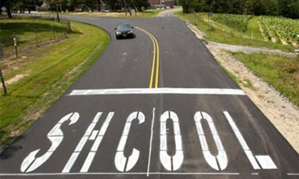
Funny Slide
As in… “Go back to…”
http://www.shiply.com/blog/uploaded_images/funny_road_signs_21-746380.jpg

Slide 33
3) CD Role
Chap 3. CD Role
3.1 CD Structure
3.2 Overview
3.3 Receiving Funds from SCC
3.4 Accounting of funds at CD
3.5 Dispersing funds to Grant Recipients
3.6 CD Educational opportunities
3.7 Program Eligibility
3.8 Administering Projects
3.9 GIS System
3.10Annual Summary Reports

Slide 34
3.3 Receiving Funds from SCC
Chap 3. CD Role
Receiving Funds from SCC
5-year agreement
Transition from DEP to PDA
Timeline for FY 2014-15 allocations

Slide 35
2.2.3 Allocations
Chap 3. CD Role
2.2.3 Allocations to Conservation Districts
D&G based largely on number and length of worksites, length of unpaved roads.
LVR based on “potential” miles of LVR in each county, weighted by proximity to stream and % in urban areas.
Full Details in Appendix U.
Allocations at www.dirtandgravelroads.org

Slide 36
3.3.2-3: Advanced Working Capital
Chap 3. CD Role
Advanced Working Capital
CD advanced 50% of allocations.
  Both D&G and LVR Allocations
  Will come with “Allocation Worksheet” outlining spending categories…

Slide 37
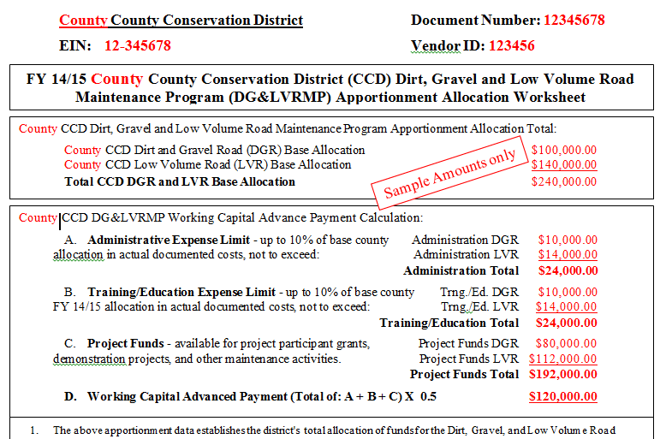
Allocation Worksheet
Chap 3. CD Role

Slide 38
Replenishment
Chap 3. CD Role
Replenishment used by Districts to request remaining funds from SCC
  Districts get 50% of allocation up front
  Must request replenishment for remainder after funds are spent (i.e. out the door).
  Can be all at once, or in several requests

Slide 39
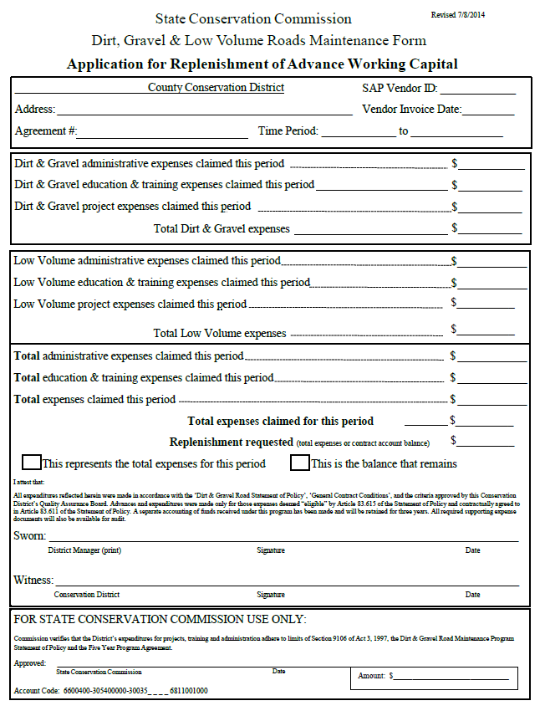
Replenishment
Chap 3. CD Role
NEW form includes D&G and LVR funds
  D&G/LVR funds , must be tracked separately
  Can request D&G, LVR, or both using one form.
Appendix K
in manual

Slide 40
Replenishment
Chap 3. CD Role
Top
Appendix K
in manual

Slide 41
Replenishment
Chap 3. CD Role
Bottom
This form goes to Roy Richardson at SCC.
Appendix K
in manual

Slide 42
3.3.4: Spending Requirements
Chap 3. CD Role
Spending Requirements
Funds must be spent or committed within two years of receipt in order to be eligible for future allocations.
If a District misses a year, can be eligible in future years if they meet future requirements.
D&G and LVR spending tracked separately.
Checked every year during annual summary reporting.

Slide 43
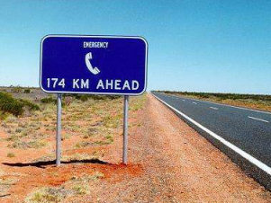
Funny Slide
I hope it’s a “minor” emergency…
http://www.top10-selfdrive-holidays.com/wp-content/gallery/funny-road-signs/funny-road-sign-14.jpg

Slide 44
3) CD Role
Chap 3. CD Role
3.1 CD Structure
3.2 Overview
3.3 Receiving Funds from SCC
3.4 Accounting of funds at CD
3.5 Dispersing funds to Grant Recipients
3.6 CD Educational opportunities
3.7 Program Eligibility
3.8 Administering Projects
3.9 GIS System
3.10Annual Summary Reports

Slide 45
3.4.1: Separate Accounting
Chap 3. CD Role
Separate Accounting
Separate accounting, not necessarily separate accounts.
Federally Insured Accounts.
D&G and LVR funds tracked separately

Slide 46
3.4.2-4 CD Spending Categories
Chap 3. CD Role
Spending Categories
Up to 10% administration.
Up to 10% education.
At least 80% on projects.
Other Considerations:
  Separate for D&G and LVR funds.
  All interest must go to projects
Overview only, details to come on next few slides

Slide 47
3.4.2: Administrative Funds
Chap 3. CD Role
Administrative Funds
Up to 10% of allocations
Both D&G and LVR
Up to 100% of funds can be used on projects!
Example expenses:
  Staff salary to administer the Program
  Travel expenses related to Program administration
  Office and technology expenses
  Field equipment
  Aggregate testing
  Insurance
  Vehicle expenses
  Traffic Counters, grader blades, or other equipment to loan to applicants
  Other administrative expenses pertinent to the Dirt, Gravel, and Low Volume Road Maintenance Program.

Slide 48
3.4.3 Education Funds
Chap 3. CD Role
Education Funds
Up to 10% of allocations
Both D&G and LVR
Up to 100% of funds can be used on projects!
Example expenses:
  Staff salary related to trainings, conferences, field days, and workshops (attending or hosting), technical assistance, or other outreach activities.
  Travel expenses related to above activities.
  Expenses of hosting workshops.
  Educational related office and technology expenses.
  Educational materials or advertisements.
  Traffic Counters, grader blades, or other equipment to loan to applicants.
  Expenses for potential grant applicants to attend educational and training.

Slide 49
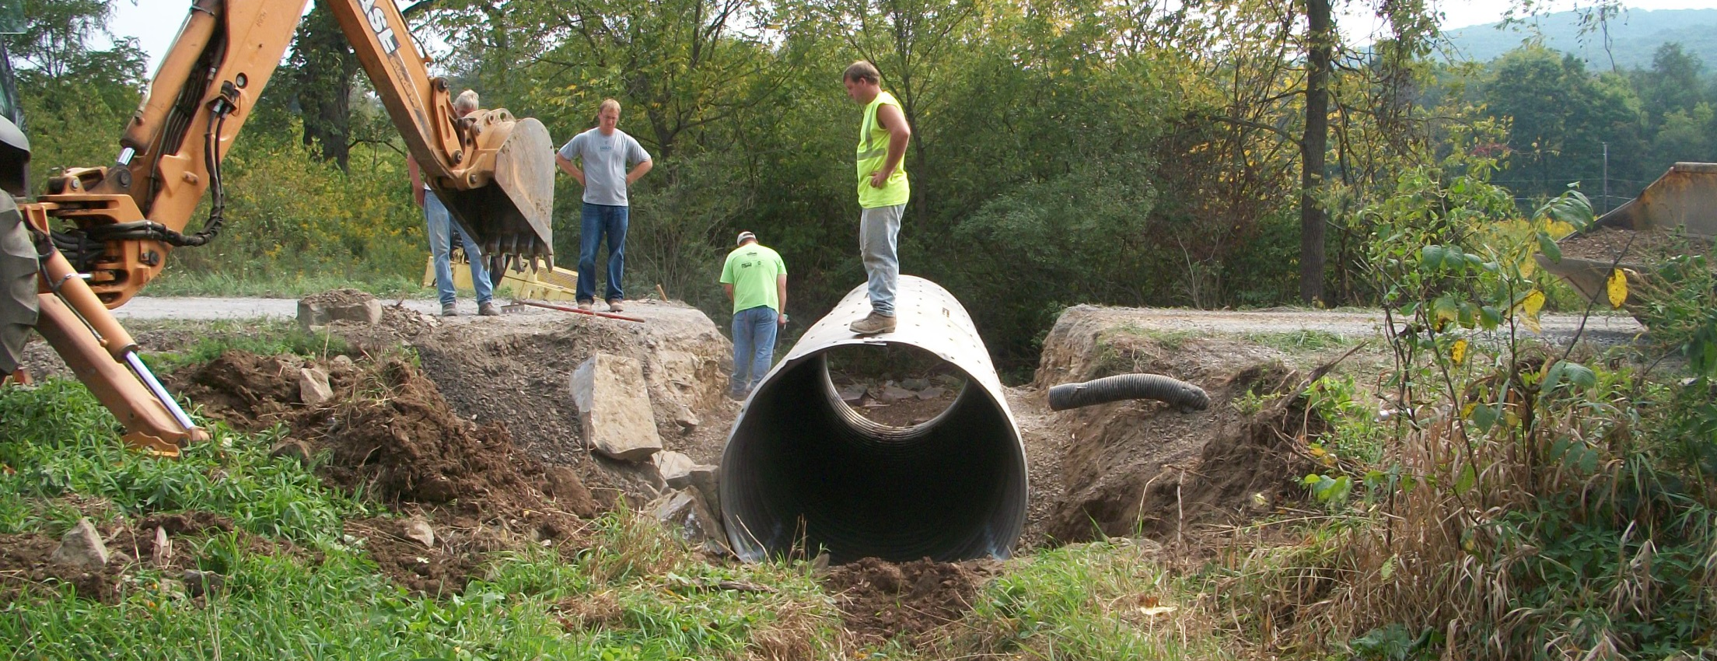
3.4.4: Project Funds
Chap 3. CD Role
Project Funds
At least 80% of funds must go to projects.
Admin and Education funds can go to projects too.

Slide 50
3.4.5: Interest Funds
Chap 3. CD Role
Interest Funds
ALL interest in ALL categories (even admin and edu) must be spent on projects.
D&G interests should go to D&G projects, LVR interest should go to LVR projects.

Slide 51
3.4.6 Demonstration projects
Chap 3. CD Role
Demonstration Projects
District-funded outside of ranking system.
Showcase new technology, education site, etc.
  Only education or administrative funds can be used.
  Must follow existing Program policies: be on an eligible public road; focus on environmental improvements; meet LVR traffic counts; etc.
  Must have QAB and district board Approval.
  Must have a contract, MOU, or other agreement with the road-owning entity.
  Contact Center or Commission staff before contracting a Demo project.

Slide 52
3.4.6 Demonstration projects
Chap 3. CD Role
Demonstration Projects
Do not use to circumvent standard training requirements and normal project agreements.
  Regular project (application, ranking) - any funds
  Demo Project – admin/edu funds only
You can do “education and outreach” efforts on any project.

Slide 53
3) CD Role
Chap 3. CD Role
3.1 CD Structure
3.2 Overview
3.3 Receiving Funds from SCC
3.4 Accounting of funds at CD
3.5 Dispersing funds to Grant Recipients
3.6 CD Educational opportunities
3.7 Program Eligibility
3.8 Administering Projects
3.9 GIS System
3.10Annual Summary Reports

Slide 54
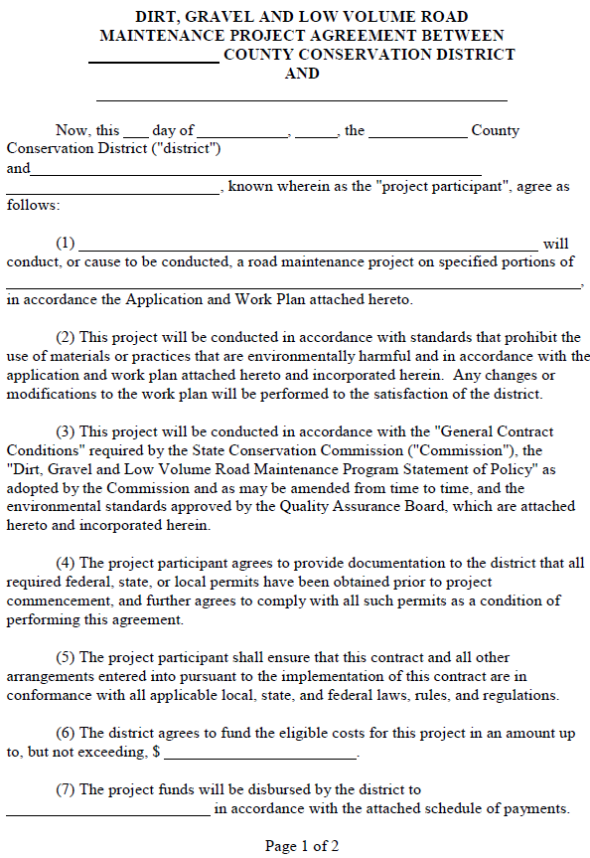
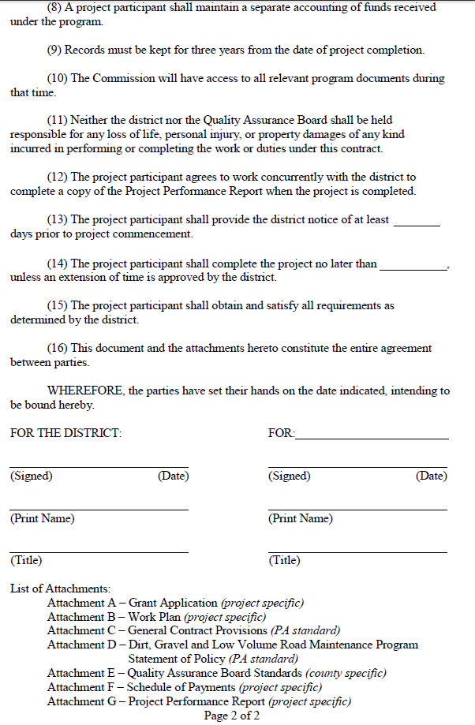
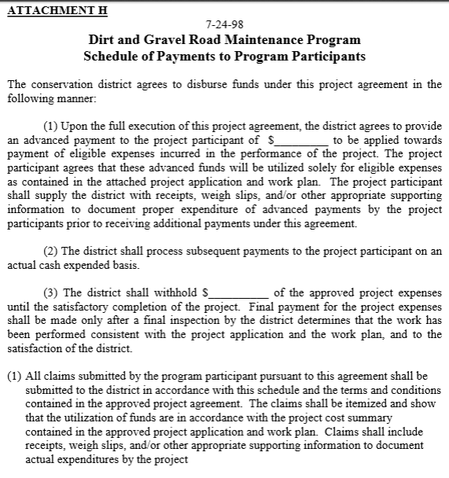
3.5.1-2 Providing funds to grant recipients
Chap 3. CD Role
Providing Funds to Grant Recipients
Two page contract.
Schedule of payments (up to 50% may be advanced).
Includes multiple attachments.
Simple one-page amendment if needed.
Details of forms to follow in section 3.8.

Slide 55
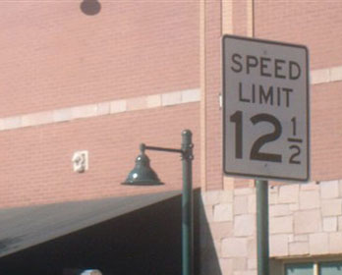
Funny Slide
Has to be a lawyer involved…
http://www.rd.com/slideshows/funny-road-signs/

Slide 56
3) CD Role
Chap 3. CD Role
3.1 CD Structure
3.2 Overview
3.3 Receiving Funds from SCC
3.4 Accounting of funds at CD
3.5 Dispersing funds to Grant Recipients
3.6 CD Educational opportunities
3.7 Program Eligibility
3.8 Administering Projects
3.9 GIS System
3.10Annual Summary Reports

Slide 57
3.6.1 ESM Training
Chap 3. CD Role
ESM Training
2 day course that covers road maintenance principals
Mandatory for district staff involved with the program
Mandatory for at least one district QAB member
Highly recommended for everyone else
Good for 5 yrs
Who here has been to ESM?

Slide 58
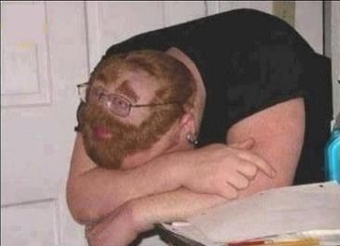
3.6.2 Administrative training
Chap 3. CD Role
Admin Training (ZZZzzzzz…)
Covers administrative policies and guidance provided in the admin manual
Required for staff persons most involved with the program
Good for 3 yrs.
http://anintrospectiveworld.blogspot.com/2012/08/sleeping-in-class.html

Slide 59
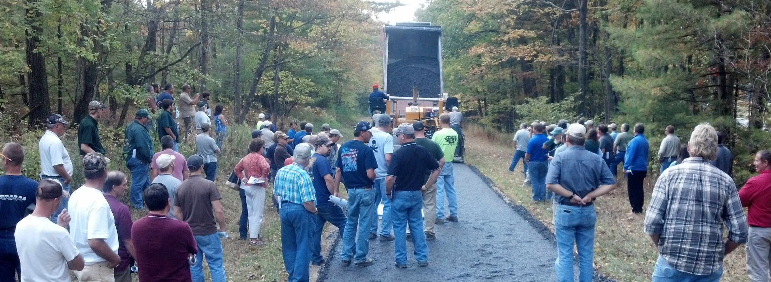
3.6.3 Annual Maintenance Workshop
Chap 3. CD Role
Annual Maintenance Workshop
More in depth training than ESM
ESM certified individual may attend annual workshop at least once every 5 yrs in lieu of ESM training

Slide 60
3.6.5 Technical Assists
Chap 3. CD Role
Technical Assistance
Conducted primarily by Center staff
Initiated by districts
Small group training for districts and municipalities
Help with:
  Project design / layout
  Meet with applicants
  Aggregate placement
  Project implementation
  Whatever you need!

Slide 61
Other Documentation
Chap 3. CD Role
Other Documentation
www.dirtandgravelroads.org
Technical bulletins
Sample forms and policies
Blank forms
Aggregate guidance
GIS help
Reference material

Slide 62
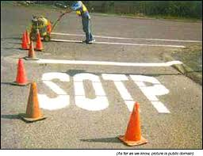
Funny Slide
Notice they painted the grass as well…
http://www.shiply.com/blog/uploaded_images/funny_road_signs_21-746380.jpg

Slide 63
3) CD Role
Chap 3. CD Role
3.1 CD Structure
3.2 Overview
3.3 Receiving Funds from SCC
3.4 Accounting of funds at CD
3.5 Dispersing funds to Grant Recipients
3.6 CD Educational opportunities
3.7 Program Eligibility
3.8 Administering Projects
3.9 GIS System
3.10Annual Summary Reports

Slide 64
3.7.1 Eligible Applicants
Chap 3. CD Role
Eligible Applicants
Public entities that own roads
Person in charge of the project must be ESM certified
Municipalities (1400+ twps, 800+ boroughs, 50+ cities)
State entities such as:
  PennDOT, Game Commission, Fish & Boat
  County and other Government entities
Federal roads and private roads are NOT eligible
  All public roads are “born” in legislation

Slide 65
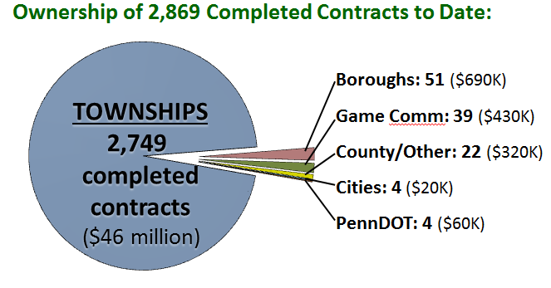
3.7.1 Eligible Applicants
Chap 3. CD Role

Slide 66
3.7.2 Eligible Roads
Chap 3. CD Role
Dirt and Gravel Road
  “Unbound” surfaces.
  “gradable”
Paved Low Volume Road
  Surface bound with asphalt, oil, or other binder
  Includes “tar and chip”
  500 vehicles a day or less – traffic count required

Slide 67
3.7.3 Eligible Projects
Chap 3. CD Role
Eligible Projects
Focus on environmental and road improvements
Use ESM practices
  Reduce sediment
  Reduce concentrated drainage

Slide 68
3.7.4 Eligible Project Expenses
Chap 3. CD Role
Eligible Project Expenses
No program specific purchase requirements (use established procedures)
Records of purchases must be kept (by the grant recipient) for 3 years from project completion
Applicants can apply for the full cost of all materials, equipment, and labor

Slide 69
3.7.4 Eligible Expenses - Materials.
Chap 3. CD Role
Materials
Typical materials include pipe, stone, fabric, etc
Products with leaching potential must meet SCC standards for non-pollution. Approved products list on www.dirtandgravelroads.org.

Slide 70
3.7.4 Eligible Expenses - Equipment
Chap 3. CD Role
Equipment
Reimbursement of applicant owned equipment is eligible (@ FEMA rates)
Equipment can be rented, FEMA rates do not apply.
No purchase or maintenance of equipment.

Slide 71
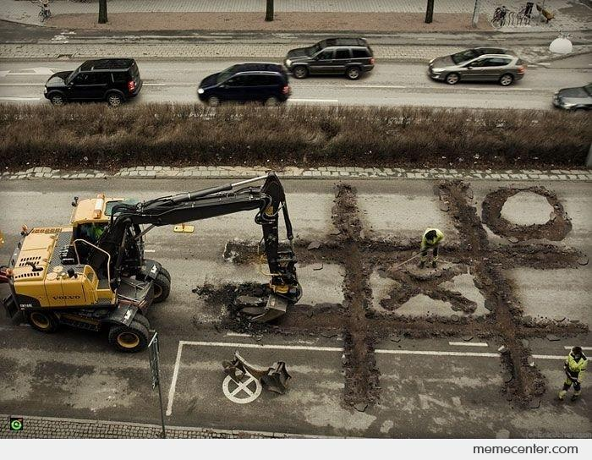
Funny Slide
Does this go under equipment, or labor???

Slide 72
3.7.4 Eligible Expenses - Labor
Chap 3. CD Role
Labor
Reimbursement of labor and equipment operators is an eligible expense

Slide 73
3.7.4 Eligible Expenses - Labor
Chap 3. CD Role
Labor
Reimbursement of labor and equipment operators is an eligible expense
PREVAILING WAGE: Does not apply to projects done with Municipal labor force.

Slide 74
3.7.4.2 Contractor Costs
Chap 3. CD Role
Contractors
Projects may be completed in whole or in part by contractors
Grant recipients use their standard bidding procedures
Districts must make payments to the grant recipient, not the contractors
PREVAILING WAGE:

Slide 75
3.7.4.2 Contractor Costs
Chap 3. CD Role
PREVAILING WAGE: Projects where the estimated total project cost exceeds $25,000 (NOT $100,000) are subject to the prevailing wage act for contracted labor.
  It is the responsibility of the grant recipient to obtain the Prevailing Wage Act scale for the area and include it in any proposal to solicit bids for the contract. The Prevailing Wage scale can be obtained from the Prevailing Wage Division of the Pennsylvania Department of Labor and Industry. If the Prevailing Wage Act applies, the advertisement shall also note this fact.

Slide 76
3.7.4.2 Contractor Costs
Chap 3. CD Role
PREVAILING WAGE: Projects where the estimated total project cost exceeds $25,000 (NOT $100,000) are subject to the prevailing wage act for contracted labor.
  Total Project Costs: include other grant sources in-kind material (not equipment/labor).
  Cannot “split” projects to avoid PW.
  PW Never applies to municipal labor.

Slide 77
3.7.4.2 Contractor Costs
Chap 3. CD Role
PREVAILING WAGE EXAMPLES:
$25,001 Contract
  PW applies to any contracted labor only.

Slide 78
3.7.4.2 Contractor Costs
Chap 3. CD Role
PREVAILING WAGE EXAMPLES:
$25,001+ Contract
  PW applies to any contracted labor only.
$24,000 Contract + $2,000 in-kind (materials)
  PW applies to any contracted labor only.

Slide 79
3.7.4.2 Contractor Costs
Chap 3. CD Role
PREVAILING WAGE EXAMPLES:
$25,001+ Contract
  PW applies to any contracted labor only.
$24,000 Contract + $2,000 in-kind (materials)
  PW applies to any contracted labor only.
$24,000 Contract + $5,000 outside grant
  PW applies to any contracted labor only.

Slide 80
3.7.4.2 Contractor Costs
Chap 3. CD Role
PREVAILING WAGE EXAMPLES:
$25,001+ Contract
  PW applies to any contracted labor only.
$24,000 Contract + $2,000 in-kind (materials)
  PW applies to any contracted labor only.
$24,000 Contract + $5,000 outside grant
  PW applies to any contracted labor only.
$24,000 Contract + $5,000 in-kind (eqip/lab)
  PW does NOT apply.

Slide 81
3.7.4.2 Contractor Costs
Chap 3. CD Role
PREVAILING WAGE NOTE:
  Be cautious of projects that are “just under” prevailing wage threshold of $25,000.
  Amendments could increase it over the threshold.
  Example: A $24,000 contract with a $4,800 amendment = $28,800 (PW would apply to any contracted labor on whole project)

Slide 82
3.7.4.3 Engineering and Permitting Costs
Chap 3. CD Role
Engineering, permitting, or similar consultant costs are limited to a maximum of 10% of the total contract between the District and the grant recipient.
  Example a district enters into a contract for a pipe replacement. Contract amount is $30,000, but with in-kind match, etc, the total cost is $50,000. What is the maximum amount that can be reimbursed for engineering?

Slide 83
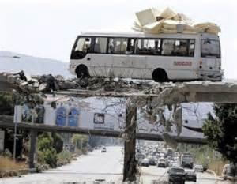
Funny Slide
Speaking of Engineering…
http://www.rd.com/slideshows/funny-road-signs/

Slide 84
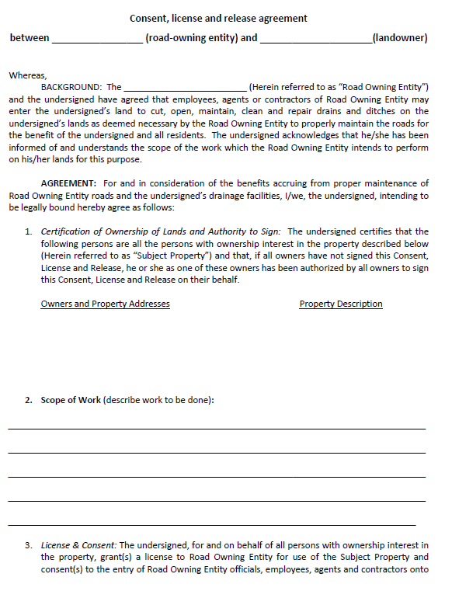
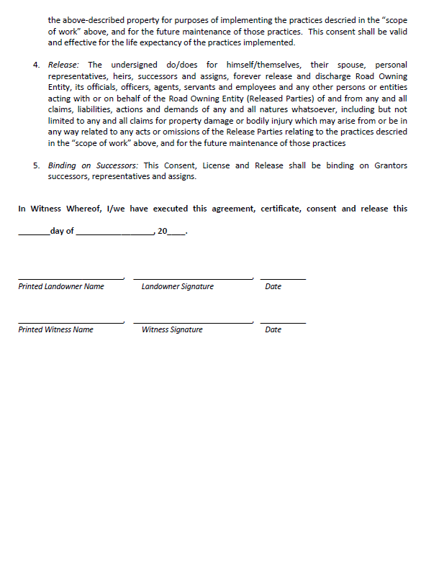
3.7.4.4 Working off the Right of way
Chap 3. CD Role
Written permission required when working outside the right-of-way.
Districts can use their own form, or the example provided in manual, but must use something!
Appendix O
in manual

Slide 85
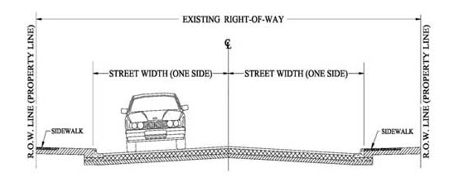
3.7.4.4 Working off the Right of way
Chap 3. CD Role
Right-of-way:
  Publicly owned road corridor.
  Typically 33’ width (16.5’ from road Centerline) for municipal roads.
  Exceptions do apply, sometime up to 50’.
http://old.mcallen.net/landingpages/lp_engineering/roa_permits.aspx

Slide 86
3.7.4.4 Working off the Right of way
Chap 3. CD Role
Working outside the right-of-way is permissible with DGLVR funds
Better to handle water before it gets to road.
  Driveway or access road reshaping, pipe, diverter.
  Interceptor swales.
  Utility line drainage.
  Etc.

Slide 87
3.7.4.4 Working off the Right of way
Chap 3. CD Role
Working outside the right-of-way is permissible with DGLVR funds only under certain conditions:
Must be directly necessary to the successful completion of the project
Limited in scope to cost effective practices that directly reduce road impacts
Grant recipient MUST obtain written permission before starting the project
Districts must keep a copy of written permission in the project file

Slide 88
3.7.4.4 Working off the Right of way
Chap 3. CD Role
Landowner permission is suggested when off-right-of-way impacts are expected, even if work is done within write-of-way.
New pipes and turnouts.
Subsurface drainage
Driveway issues.
Road fill jobs.

Slide 89
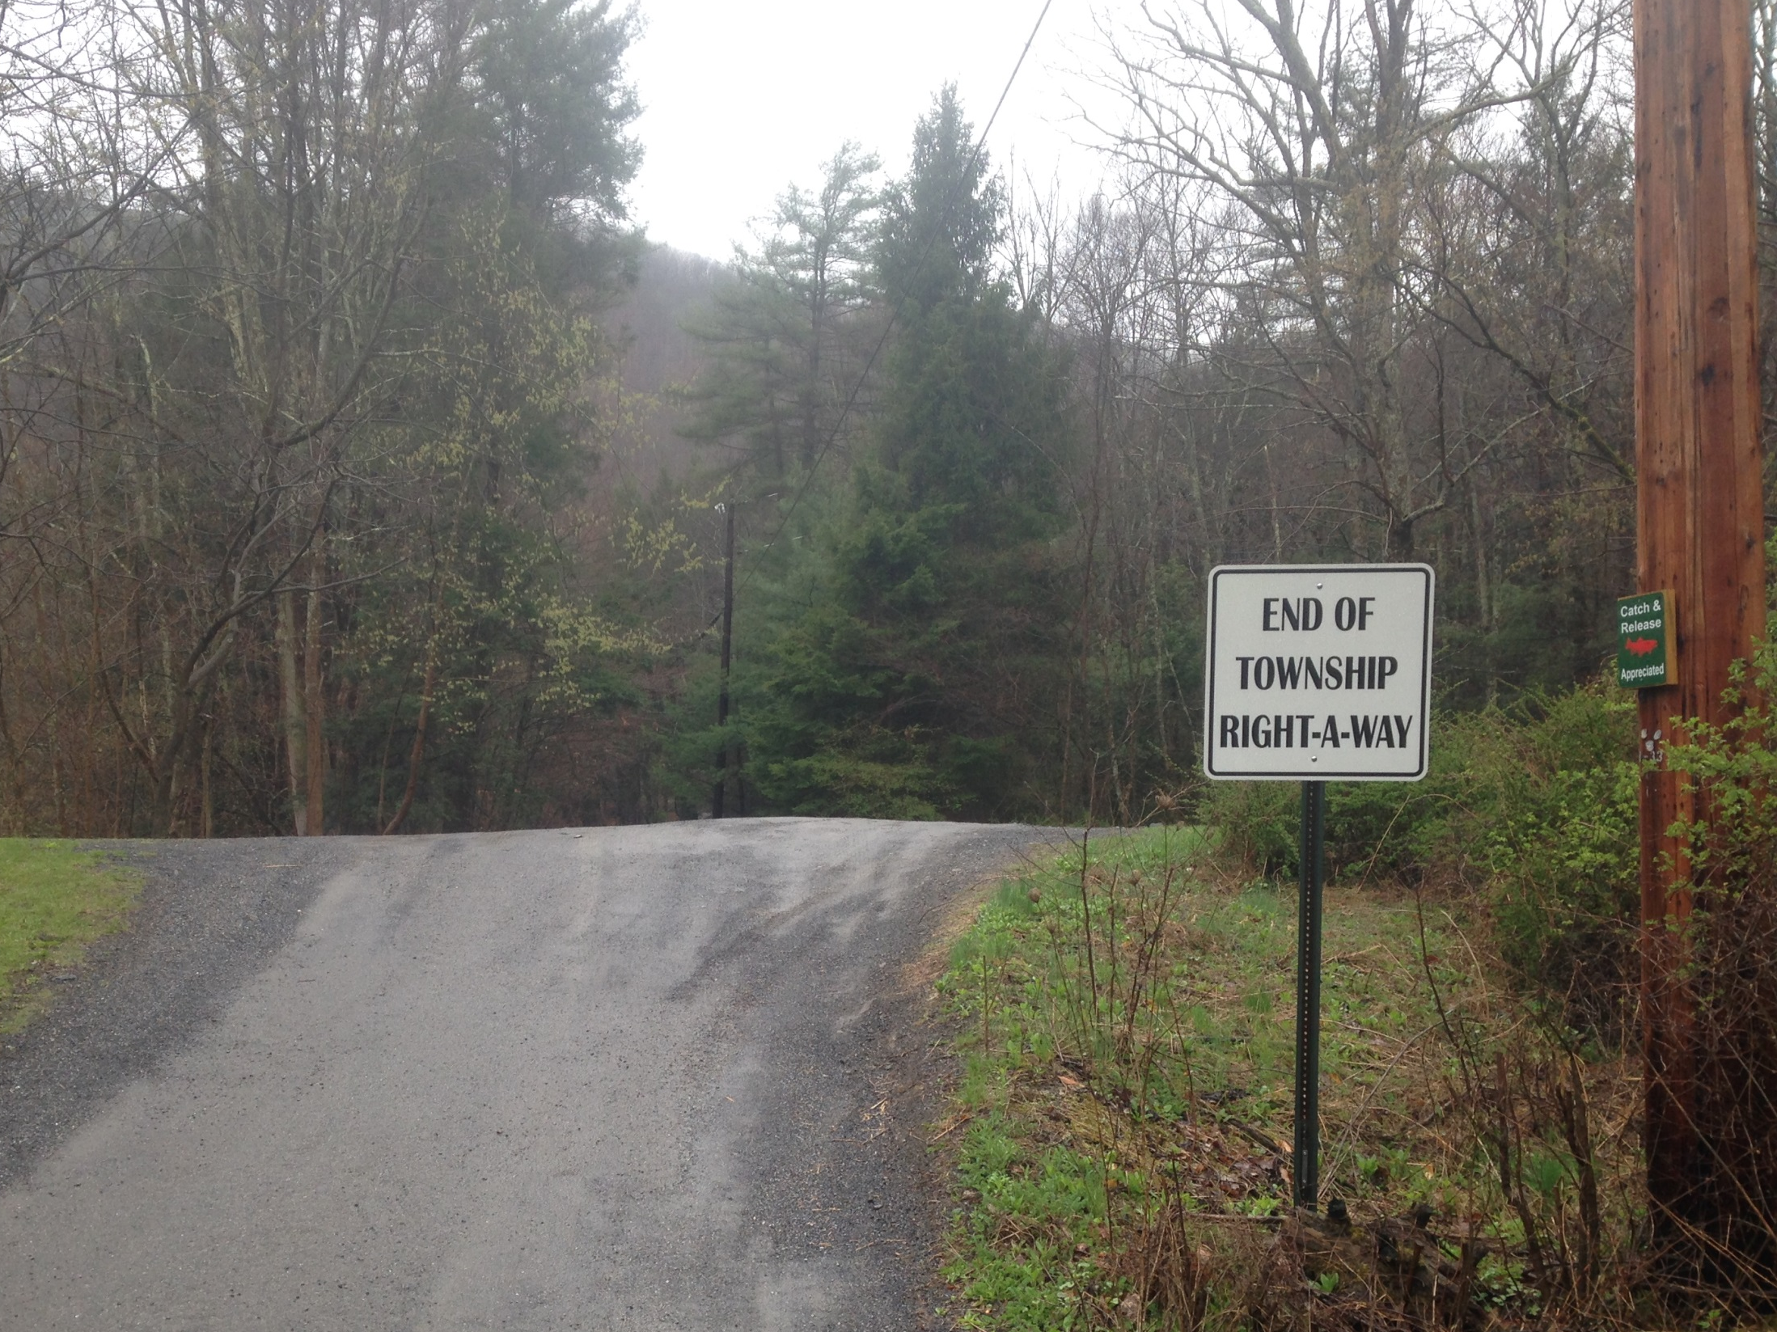
This Township Ends… IMMEDIATELY!!!
This township ends… IMMEDIATELY!

Slide 90
3.7.4.5 Combined Funds
Chap 3. CD Role
Combined Funds
Program funds can be combined with other funds under certain conditions:
  Detailed accounting of who paid for what
  Other funds may be used as matching funds
  The project must adhere to the commission’s non pollution standards

Slide 91
3.7.4.5 Combined Funds
Chap 3. CD Role
Combined Funds
“Piggybacking” a project?
  A twp already plans to repave a road.
  You could fund ~40,000 in drainage work before they repave.
  You get the environmental improvement without paying for paving.
  Twp gets a longer lasting road and pavement without paying for drainage.

Slide 92
3) CD Role
Chap 3. CD Role
3.1 CD Structure
3.2 Overview
3.3 Receiving Funds from SCC
3.4 Accounting of funds at CD
3.5 Dispersing funds to Grant Recipients
3.6 CD Educational opportunities
3.7 Program Eligibility
3.8 Administering Projects
3.9 GIS System
3.10Annual Summary Reports

Slide 93
3) CD Role
Chap 3. CD Role
3.8 Administering Projects
  3.8.1 notifying applicant
  3.8.2 pre-app site visit
  3.8.3 receiving applications
  3.8.4 contracting
  3.8.5 pre-project logistics
  3.8.6 project oversight
  3.8.7 project completion/ closeout

Slide 94
3.8.1 Notifying applicants
Chap 3. CD Role
Notifying Applicants
Districts must inform all potential applicants of funding availability (equal access).
QAB equal access policy.

Slide 95
3.8.2 Pre-Application site visit
Chap 3. CD Role
Pre-app site visit
Districts should meet with potential applicants on site BEFORE an application is submitted
Early discussion of potential problems (permitting, funding availability, etc)
Best interest of both parties.
Look at potential landowner or off-ROW issues

Slide 96
3) CD Role
Chap 3. CD Role
3.8 Administering Projects
  3.8.1 notifying applicant
  3.8.2 pre-app site visit
  3.8.3 receiving applications
  3.8.4 contracting
  3.8.5 pre-project logistics
  3.8.6 project oversight
  3.8.7 project completion/ closeout

Slide 97
3.8.3 Receiving Grant Applications 1/2
Chap 3. CD Role
Receiving Grant Apps: Timeline
  Receive Applications
  Work with applicants to revise if needed.
  Review for completeness and accuracy.
  All of the completed applications get forwarded to QAB for review and ranking.
  QAB recommendations taken to District Board for action
  Contract can then be made with grant recipient.

Slide 98
3.8.3 Receiving Grant Applications 2/2
Chap 3. CD Role
Receiving Grant Apps
Districts may set application periods, or they may have an open application period
One page application
Districts may develop their own policy for unfunded applications
  Disapprove
  Retain
  Resubmit

Slide 99
Grant App, Work plan, Instructions
Chap 3. CD Role
Grant app and forms used to apply to CD
Revised project-specific Grant Application
NEW optional cost summary forms
Revised Project Sketch (back of grant app)
New Instructions for all forms

Slide 100
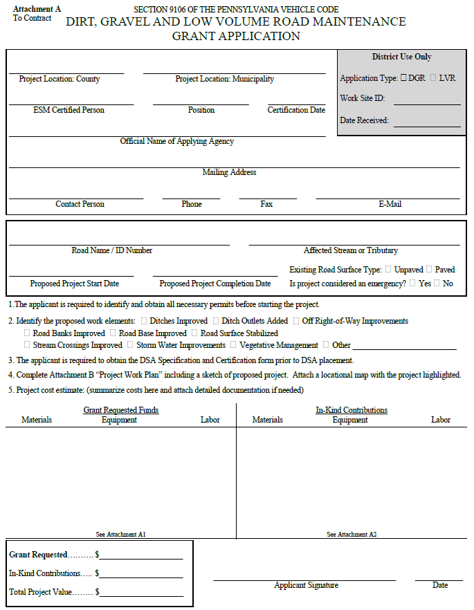
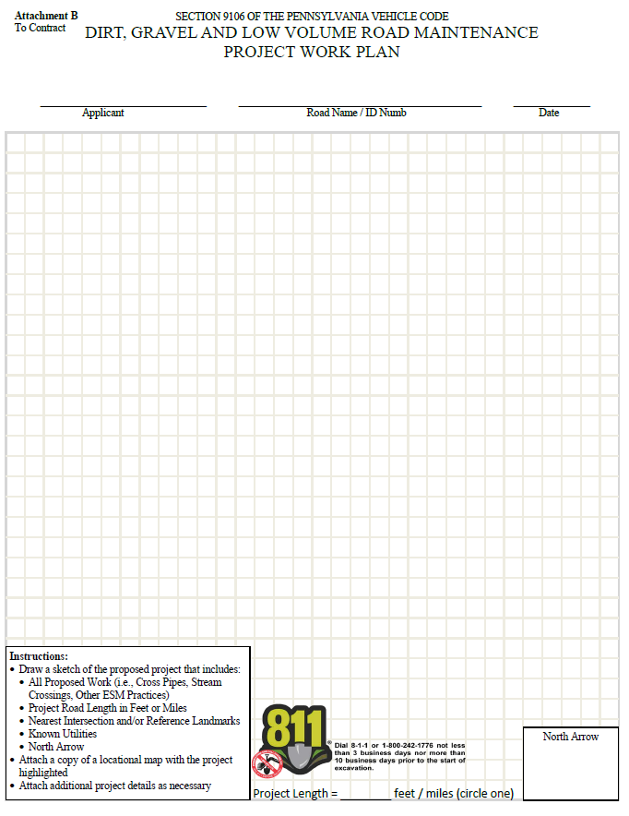
Grant App, Work plan, Instructions
Chap 3. CD Role
Grant Application (front)
Project Sketch
(back)
2 page “cheat sheet” for new CD hires.
Appendix E
in manual

Slide 101
Grant App, Work plan, Instructions
Chap 3. CD Role
Grant App - Top
NEW District Use Only Box
2 page “cheat sheet” for new CD hires.
Applicant Info
Project Info
Appendix E
in manual

Slide 102
E. Grant App, Work plan, Instructions
Forms Update
Grant App - Bottom
Questions changed slightly
2 page “cheat sheet” for new CD hires.
Additional Cost Sheets Available
Cost Summary
Appendix E
in manual

Slide 103
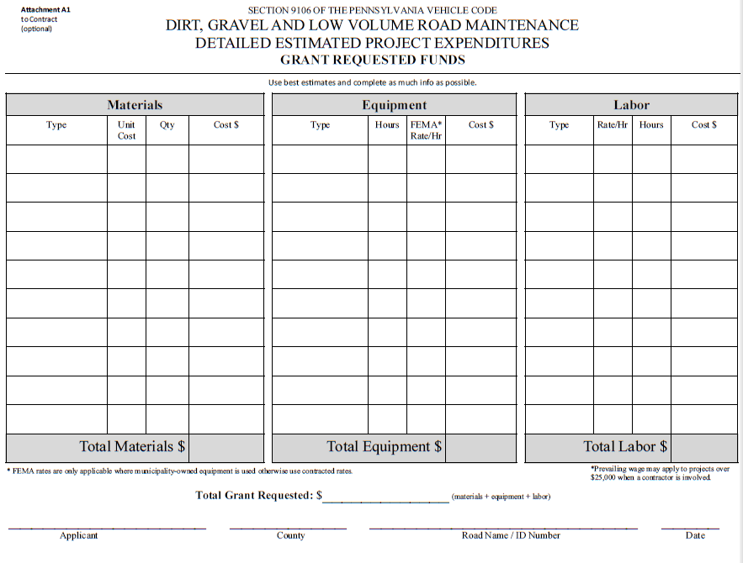
Grant App, Work plan, Instructions
Chap 3. CD Role
NEW OPTIONAL Form
2 page “cheat sheet” for new CD hires.
Appendix E
in manual

Slide 104
Grant App, Work plan, Instructions
Chap 3. CD Role
NEW OPTIONAL Form
Bottom of Grant Application
2 page “cheat sheet” for new CD hires.

Slide 105
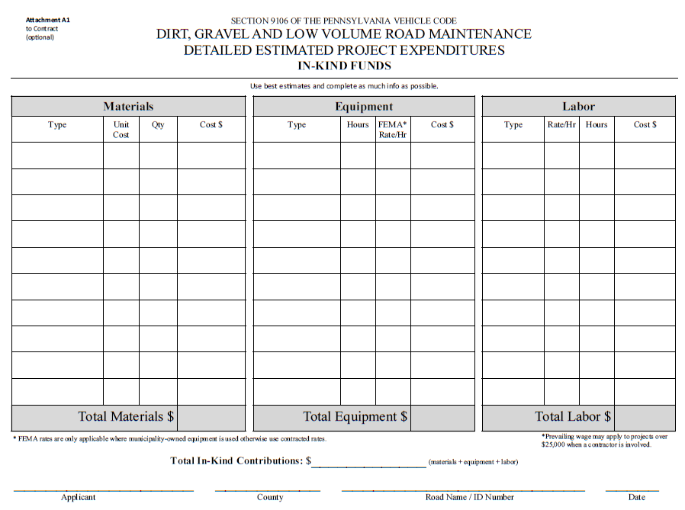
Grant App, Work plan, Instructions
Chap 3. CD Role
NEW OPTIONAL Form
2 page “cheat sheet” for new CD hires.
Appendix E
in manual

Slide 106
Grant App, Work plan, Instructions
Chap 3. CD Role
NEW OPTIONAL Form
Bottom of Grant Application
2 page “cheat sheet” for new CD hires.

Slide 107
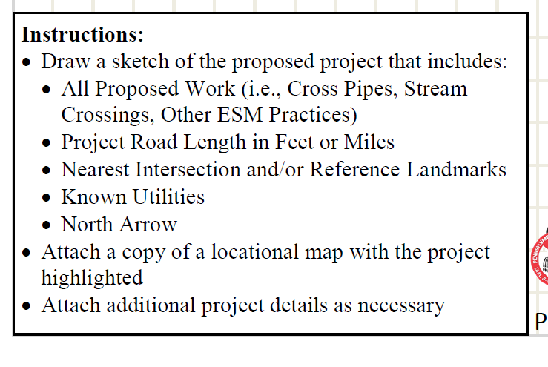
Grant App, Work plan, Instructions
Chap 3. CD Role
Project Sketch
(back of grant app)
2 page “cheat sheet” for new CD hires.
Appendix E
in manual

Slide 108
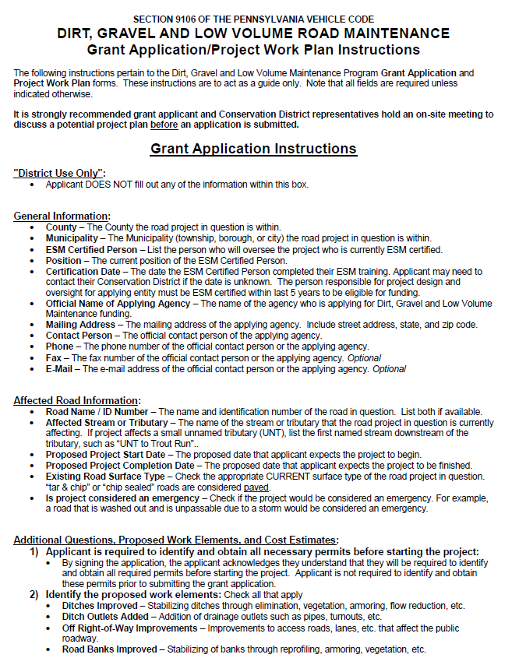
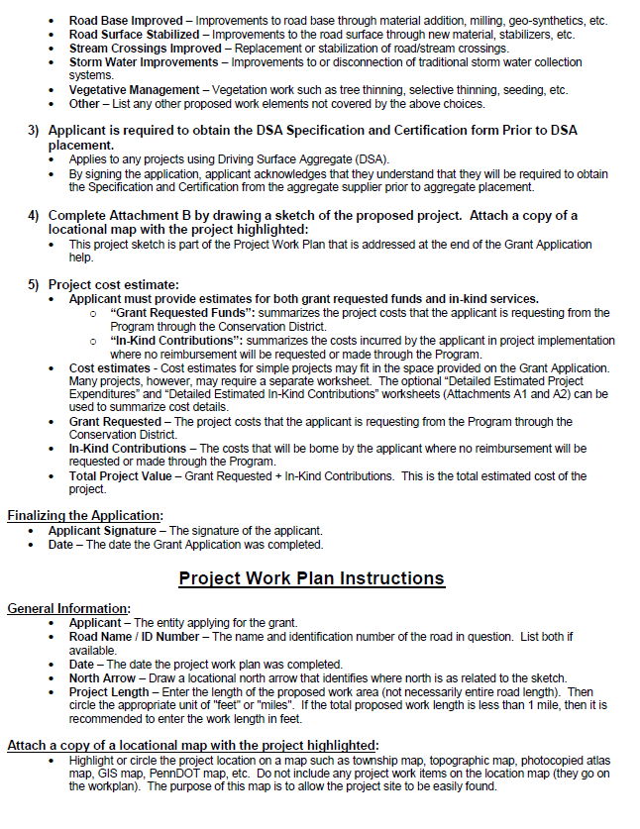
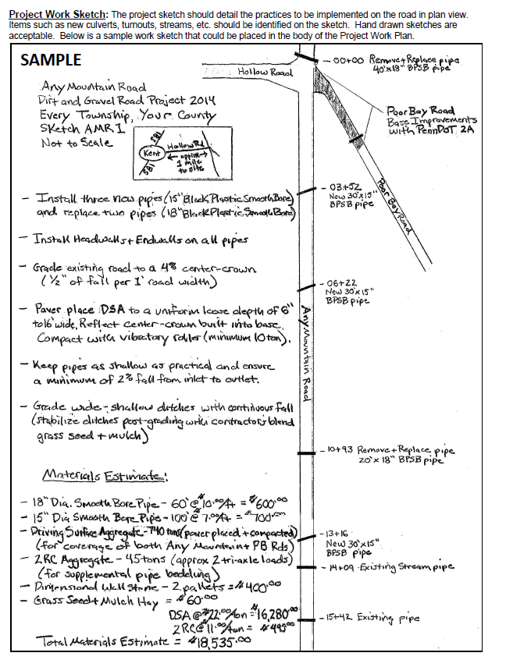
Grant App, Work plan, Instructions
Chap 3. CD Role
Grant App Instructions, Sample Sketch
2 page “cheat sheet” for new CD hires.
Appendix E
in manual

Slide 109
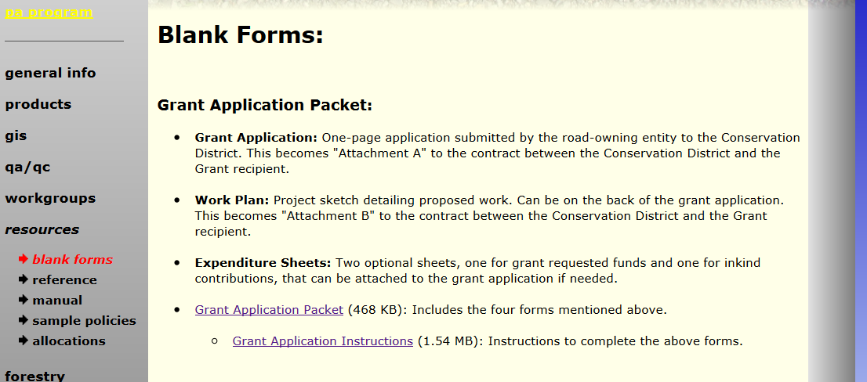
E. Grant App, Work plan, Instructions
Chap 3. CD Role
New forms available online
  With or without instructions

Slide 110
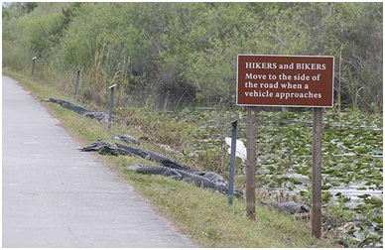
Funny Slide
No Thanks.
http://www.shiply.com/blog/uploaded_images/funny_road_signs_21-746380.jpg

Slide 111
3) CD Role
Chap 3. CD Role
3.8 Administering Projects
  3.8.1 notifying applicant
  3.8.2 pre-app site visit
  3.8.3 receiving applications
  3.8.4 contracting
  3.8.5 pre-project logistics
  3.8.6 project oversight
  3.8.7 project completion/ closeout

Slide 112
3.8.4 Contracting
Chap 3. CD Role
Contracting
Contract must be in place before anything happens
  No fund advances can take place without a contract
  No work can begin without a contract

Slide 113
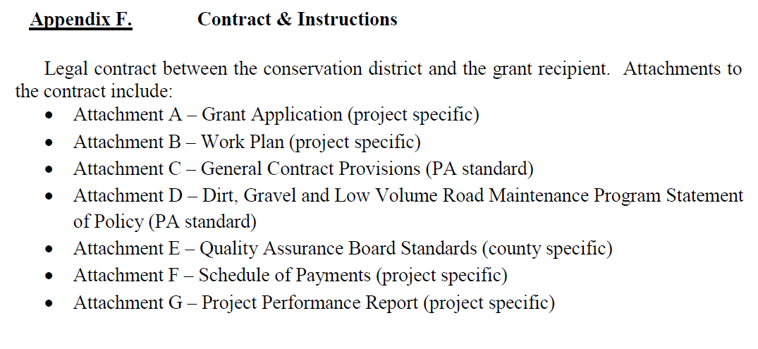
Contract
Chap 3. CD Role
2-page contract between CD and grantee
Minor changes
Other documents attached to contract:

Slide 114
Contract
Grant App Instructions, Sample Sketch
Chap 3. CD Role
2 page “cheat sheet” for new CD hires.
Appendix F
in manual

Slide 115
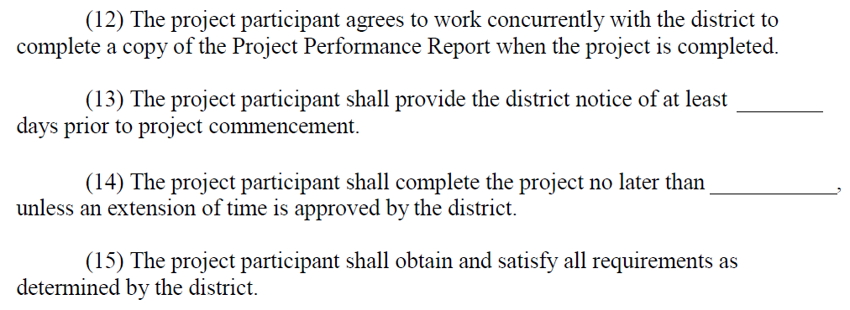
Contract
Grant App Instructions, Sample Sketch
Chap 3. CD Role
2 page “cheat sheet” for new CD hires.
Appendix F
in manual

Slide 116
Contract
Chap 3. CD Role
2-page contract between CD and grantee
CDs can add provisions to contract
  Need to be approved by your solicitor.
  Need to notify SCC.

Slide 117
Schedule of Payments
Chap 3. CD Role
50% max
30% min
Appendix I
in manual

Slide 118
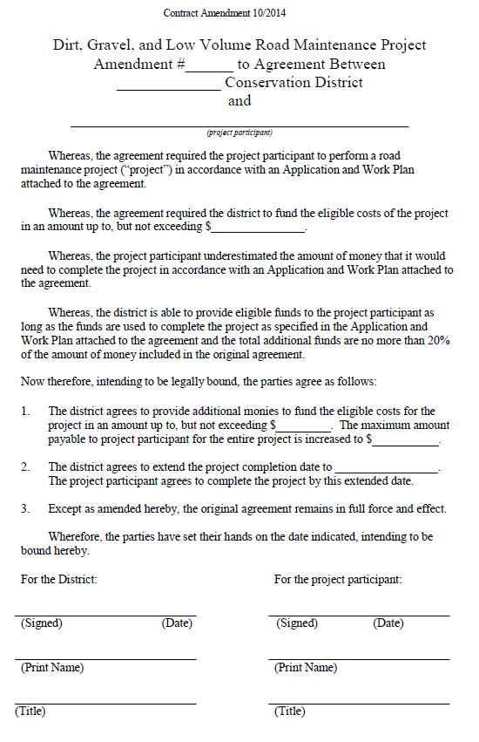
Contract Amendment
Chap 3. CD Role
If needed, a simple one-page amendment form can be used to:
  increase contract by up to 20% (was 10%) (total of original contract)
  extend completion date new
  both of above
Appendix H
in manual

Slide 119
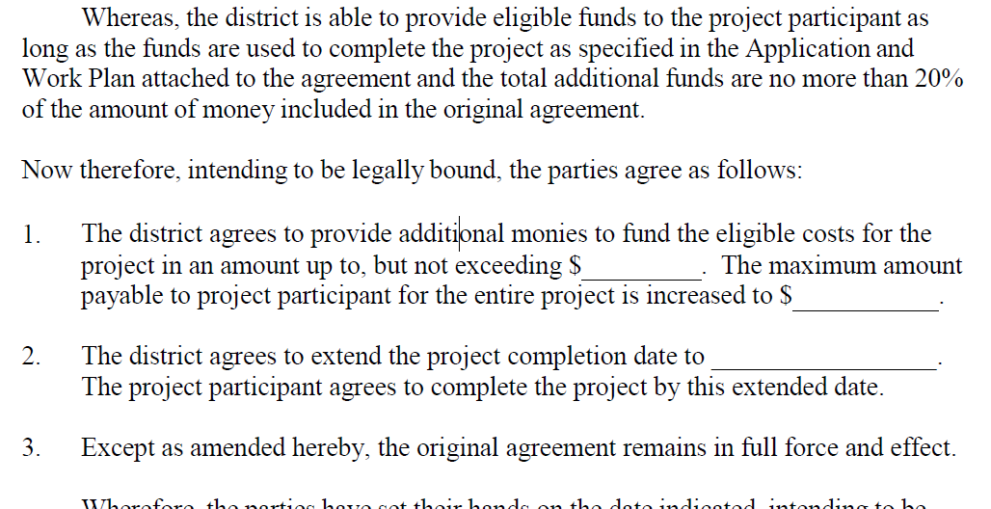
Contract Amendment
Chap 3. CD Role
Limit increased from 10% to 20% of contract
Can now be used to extend completion date.
Appendix H
in manual

Slide 120
3.7.4.2 Contractor Costs
Chap 3. CD Role
PREVAILING WAGE NOTE:
  Be cautious of projects that are “just under” prevailing wage threshold of $25,000.
  Amendments could increase it over the threshold.
  Example: A $24,000 contract with a $4,800 amendment = $28,800 (PW would apply to any contracted labor on whole project)

Slide 121
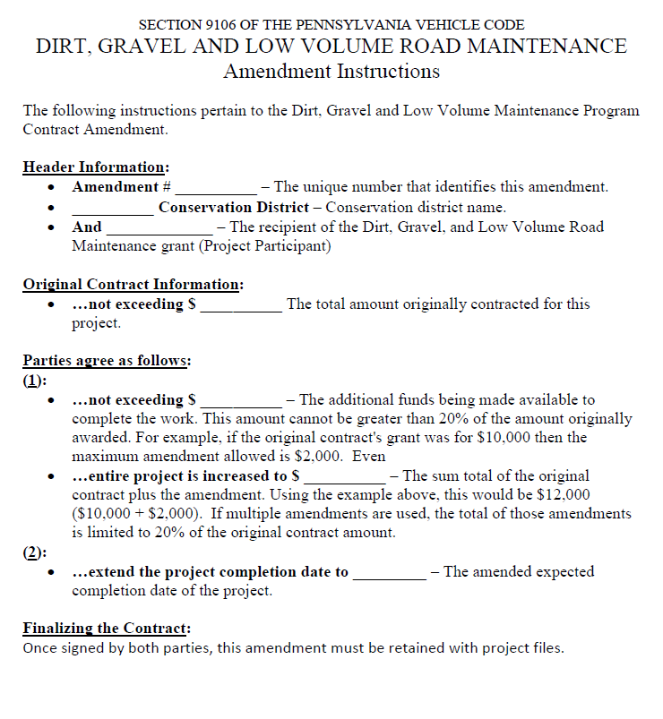
Contract Amendment
Chap 3. CD Role
NEW Amendment Instructions
Can now be used to extend completion date.
Appendix H
in manual

Slide 122
3) CD Role
Chap 3. CD Role
3.8 Administering Projects
  3.8.1 notifying applicant
  3.8.2 pre-app site visit
  3.8.3 receiving applications
  3.8.4 contracting
  3.8.5 pre-project logistics
  3.8.6 project oversight
  3.8.7 project completion/ closeout

Slide 123
3.8.5 Pre-project logistics
Chap 3. CD Role
Pre project logistics
Permits, Pa 1-call
  It is the responsibility of the grant recipient to insure that all necessary permits are obtained and any other pre-project requirements are met (1-call, PNDI, etc)
  It is the responsibility of the district to verify that permits and pre-project requirements have been met before funds can be advanced.

Slide 124
3.8.5 Pre-project logistics
Chap 3. CD Role
Pre project logistics
Pre-project meeting (separate from pre-application meeting)
  Districts should meet on site with grant recipients prior to the start of any project.
  Contractors and sub-contractors are strongly encouraged to attend.
  Notify Center of planned DSA placements. (more to come on this)

Slide 125
3) CD Role
Chap 3. CD Role
3.8 Administering Projects
  3.8.1 notifying applicant
  3.8.2 pre-app site visit
  3.8.3 receiving applications
  3.8.4 contracting
  3.8.5 pre-project logistics
  3.8.6 project oversight
  3.8.7 project completion/ closeout

Slide 126
3.8.6 Project Oversight
Chap 3. CD Role
Project Oversight
District must ensure that project work is performed in accordance with contract and attachments, including subcontractors.
    Stay involved
    Have an on-site presence
    Pay attention
    Call Center/SCC for help if needed
    No excuses!
When it comes to project oversight, remember…

Slide 127
3.8.6 Project Oversight
Chap 3. CD Role
“You get what you inspect, not what you expect”
more involvement = better projects

Slide 128

Funny Slide
Brilliant! We should do this on all our roads.
http://thismonkeyhasablog.blogspot.com/2013/09/driving-in-india-secret-revealed-be.html

Slide 129
3) CD Role
Chap 3. CD Role
3.8 Administering Projects
  3.8.1 notifying applicant
  3.8.2 pre-app site visit
  3.8.3 receiving applications
  3.8.4 contracting
  3.8.5 pre-project logistics
  3.8.6 project oversight
  3.8.7 project completion/ closeout

Slide 130
3.8.8 Project Completion
Chap 3. CD Role
Project Completion Report
Closeout summary of individual project
Encourage joint CD/grantee completion at final inspection.
  Summarizes funding
  Summarizes work
  Signed by CD and grantee
Must be signed and retained with project files.
Significant Changes

Slide 131
3.8.8 Project Completion
Chap 3. CD Role
Significant Changes - Why?
Old Form: ineffective summaries
  Vegetation Management ______Sq Ft
  Road Surface Stabilized _______Sq Ft
  Ditch Stabilized ________ Sq Ft
New form allows for better ESMP tracking.
No LVR data.

Slide 132
3.8.8 Project Completion
Chap 3. CD Role
Expanded to front and back
Project Info
ESM Practice Summary
Financial Summary
Notes and Signatures
Appendix J
in manual

Slide 133
3.8.8 Project Completion
Chap 3. CD Role
Front Top
No changes to financial data
Appendix J
in manual

Slide 134
3.8.8 Project Completion
Chap 3. CD Role
Front Back
Space for notes
CD and Grantee Signatures
Appendix J
in manual

Slide 135
3.8.8 Project Completion
Chap 3. CD Role
Back Top
Appendix J
in manual

Slide 136
3.8.8 Project Completion
Chap 3. CD Role
Back Bottom

Slide 137


3.8.8 Project Completion
Chap 3. CD Role
NEW Project Completion Report Instructions
Appendix J
in manual

Slide 138

Program Forms Update Webinar Recorded 12/17/14
Recording and PowerPoint available online
www.dirtandgravelroads.org

Slide 139
3) CD Role
Chap 3. CD Role
3.1 CD Structure
3.2 Overview
3.3 Receiving Funds from SCC
3.4 Accounting of funds at CD
3.5 Dispersing funds to Grant Recipients
3.6 CD Educational opportunities
3.7 Program Eligibility
3.8 Administering Projects
3.9 GIS System
3.10Annual Summary Reports

Slide 140

3.9 GIS reporting
Chap 3. CD Role
GIS reporting
CDs use customized GIS system to track all project location, deliverables and spending.
Use system to generate annual report to SCC.

Slide 141
3.9 GIS reporting
Chap 3. CD Role
GIS System Currently being upgraded
2014 reports done in old system (1/15/15)
Don’t enter new data after 2014 report is in!
Your data transferred to new system.
Rollout late-spring / summer 2015.
2015 reports will use new system.

Slide 142
3.9 GIS reporting
Chap 3. CD Role
Biggest Changes
Online
  Nothing to install
  We can access data
  Changes and base layer update will be instant
  Nothing to “send”.
Will have new forms
Will have ability to make LVR sites.
Brief “sneak peak”?

Slide 143
3) CD Role
Chap 3. CD Role
3.1 CD Structure
3.2 Overview
3.3 Receiving Funds from SCC
3.4 Accounting of funds at CD
3.5 Dispersing funds to Grant Recipients
3.6 CD Educational opportunities
3.7 Program Eligibility
3.8 Administering Projects
3.9 GIS System
3.10Annual Summary Reports

Slide 144
3.9 GIS reporting
Chap 3. CD Role
Annual Summary Reports
Due January 15th each year.
Summarize projects and spending from previous calendar year.
Uses GIS system.
Look for guidance in near future.
Don’t enter new data after your report is in for 2014!
2015 reports will use new system.

Slide 145


3.9 GIS reporting
Chap 3. CD Role
Annual Summary Reports

Slide 146

Funny Slide
This place has to be in California...
http://media-cache-cd0.pinimg.com/736x/4d/b5/ff/4db5ff34b780ec0332c261fa91954030.jpg

Slide 147
Administrative Manual
Introduction
SCC Role
Conservation District Role
Quality Assurance Board
Applicant Role
Center for Dirt and Gravel Roads
Additional Policies
Permits and Other Requirements
Appendices

Slide 148
4.0 Quality Assurance Board
Chap 4. QAB Role
Quality Assurance Board -§ 9106, (E)
Within the conservation district a Quality Assurance Board shall be impaneled to establish and administer the grant program. The four-member QAB is to be comprised of a nonvoting chairman appointed by the conservation district directors and one local representative appointed by each of the following entities:
(1) The Federal Natural Resource Conservation Service
(2) The Pennsylvania Fish and Boat Commission
(3) The county conservation district
If circumstances require, the chairman may vote to decide a tie vote.

Slide 149
4.0 Quality Assurance Board
Chap 4. QAB Role
Quality Assurance Board Why?

Slide 150
4.0 Quality Assurance Board
Chap 4. QAB Role
Quality Assurance Board Why?
Local Involvement and Control
NRCS – Federal: conservation and erosion
PAFBC – State: aquatics and hydrology
District – County: conservation multi-discipline
Who knows best for the County?
People in the County!

Slide 151
4.0 Quality Assurance Board
Chap 4. QAB Role
Quality Assurance Board
Local control within guidelines established by the commission.
QAB’s purpose is to advise and assist the conservation district board.
  QAB is advisory only
  District Board has the final say

Slide 152
4.1 QAB Composition
Chap 4. QAB Role
Composition of the QAB is established by law:
  Only 4 members
    Non-voting chair appointed by district board
    One voting member appointed by the district board
    One voting member appointed by Fish and Boat commission
    One voting member appointed by NRCS
  Chairman may only vote to decide a tie
  Voting members appointed by the agencies do not have to be employees
  All QAB members are strongly encouraged to take ESM training
    At least one district member must take ESM training
  QAB can have as many advisors as the deem necessary, but advisors are non voting

Slide 153
Structure and Purpose
Chap 4. QAB Role
NRCS and PAFBC (not CD) designate their QAB appointees
Does not have to be NRCS/PAFBC employee.
Can also designate an alternate.
Should have appointment in writing
Sample appointment letter:

Slide 154

Structure and Purpose
Chap 4. QAB Role
Sample appointment letter:
  Voting members appointed by the agencies do not have to be employees
Available online

Slide 155
4.2 QAB Meetings
Chap 4. QAB Role
QAB Meetings
On a regular schedule or as needed
Common action items at a QAB:
  Review grant applications
  Recommend projects for funding to the district board
  Review completed projects
  Recommend local policies to district board
At least 2 of the 3 voting members (quorum) on any recommendations to the district board

Slide 156
4.2 QAB Meetings
Chap 4. QAB Role
QAB Meetings must be Sunshined
The Pennsylvania Sunshine Act requires all public agencies to take all official actions and conduct all deliberations leading up to official actions at public meetings. The Act covers all such actions by municipal governing bodies, committees of these governing bodies and municipal boards and commissions.
-Open Meetings, the Sunshine Act (Pennsylvania)

Slide 157
4.2 QAB Meetings
Chap 4. QAB Role
QAB Meetings must be Sunshined
Regular meetings may be noticed in local paper.
As needed meeting must be noticed in local paper at least 24 hours in advance.
Conference call meetings are ok, but must still be sunshined.
Must have quorum of voting members (2 of three voting members).
Must keep minutes.
  http://webpages.charter.net/gdsbmmllp/sunshine.htm

Slide 158
4.3 QAB role in projects
Chap 4. QAB Role
4.3.1 QAB Role: Project Ranking
QAB members should become familiar with applicant’s worksites:
  Site visits as a group
  Site visits individually
  Photo tour from District staff
  Paper application review only
  Throw darts at “application dartboard”
Best option
Not recommended

Slide 159
4.3 QAB role in projects
Chap 4. QAB Role
4.3.1 QAB Role: Project Ranking
Each County must have written Project Ranking Criteria
  Based on local priorities.
  Can have separate D&G and LVR or combined.
  Must provide for equal access.
  Example template available on Center’s website.

Slide 160




4.3 QAB role in projects
Chap 4. QAB Role
Appendix Q
in manual
Solution
Application Validation
Misc
Problem
Other thoughts
Ranking Criteria Webinar Recorded 12/11/14
Recording and PowerPoint available online
www.dirtandgravelroads.org

Slide 161
4.3 QAB role in projects
Chap 4. QAB Role
4.3.1 QAB Role: Project Ranking
QAB members should become familiar with applicant’s worksites
Site visit is recommended – remember sunshine laws
The Pennsylvania Sunshine Act requires all public agencies to take all official actions and conduct all deliberations leading up to official actions at public meetings. The Act covers all such actions by municipal governing bodies, committees of these governing bodies and municipal boards and commissions.
-Open Meetings, the Sunshine Act (Pennsylvania)

Slide 162
4.3 QAB role in projects
Chap 4. QAB Role
4.3.2 QAB Role: Funding Recommendations
QAB makes funding recommendations based on the ranking criteria it establishes
District board then considers QAB recommendations
When the district board approves an application, district staff may then develop and secure a contract.

Slide 163
4.3 QAB role in projects
Chap 4. QAB Role
4.3.3 QAB Role: Project Implementation
After contract is secured, district staff is responsible for project administration, oversight, and inspection.
Future funding decisions for the project may be made by the board with minimal QAB involvement.
  i.e. District board could approve a contract amendment without QAB involvement

Slide 164

Funny Slide
This must be a government funded sign…
http://www.shiply.com/blog/uploaded_images/funny_road_signs_21-746380.jpg

Slide 165
4.4 QAB Role in Policy
Chap 4. QAB Role
QAB Role in Policy
Developing local policy is a major function of the QAB:
QABs develop policy
District board adopts policy

Slide 166

4.4 QAB Role in Policy
Chap 4. QAB Role
Required Policies
Equal Access
Conflict of Interest
Project Ranking
Non-pollution Standards
Sample Policies
Required Policies
Equal Access
Conflict of Interest
Project Ranking
Non-pollution Standards

Slide 167

4.4 QAB Role in Policy
Chap 4. QAB Role
In The Works…

Slide 168
4.4 QAB Role in Policy
Chap 4. QAB Role
Optional Local Policies
QAB can recommend policies for use within County Program.
Can be “more stringent” than Statewide policy.
Cannot conflict with Statewide policy.

Slide 169
4.4 QAB Role in Policy
Chap 4. QAB Role
Optional Local Policies
Examples of acceptable local policy:
  Establishing grant submittal deadlines
  Maximum grant award of $60,000.
  Will not pay for asphalt.
  Limit DSA to within 500’ of stream.
  Maintenance policy for old projects.
  Only advance 25% of funds to grant recipient.
  Requiring 10% in-kind match.

Slide 170
4.4 QAB Role in Policy
Chap 4. QAB Role
Optional Local Policies
Examples of UNacceptable local policy:
  Allow use of 2A instead of DSA for surface
  Advance 75% of funds to grant recipient.
  All townships are eligible regardless of training.
  OK to do projects on private roads or trails.
  PennDOT Can’t apply. (or any other eligible entity)

Slide 171
4.4 QAB Role in Policy
Chap 4. QAB Role
Optional Local Policies
Examples of UNacceptable local policy:
  Allow use of 2A instead of DSA for surface
  Advance 75% of funds to grant recipient.
  All townships are eligible regardless of training.
  OK to do projects on private roads or trails.
  PennDOT Can’t apply. (or any other eligible entity)
QAB Webinar Recorded 11/20/14
Recording and PowerPoint available online
www.dirtandgravelroads.org

Slide 172

Funny Slide
wanna-joke.com

Slide 173
Administrative Manual
Introduction
SCC Role
Conservation District Role
Quality Assurance Board
Applicant Role
Center for Dirt and Gravel Roads
Additional Policies
Permits and Other Requirements
Appendices

Slide 174
5 Applicant Role
Chap 5. Applicants
5. Applicant Role
Designed as standalone section you can copy and give to new potential applicants.
Most information is repetitive from SCC and District section, just written with applicants in mind.

Slide 175
Administrative Manual
Introduction
SCC Role
Conservation District Role
Quality Assurance Board
Applicant Role
Center for Dirt and Gravel Roads
Additional Policies
Permits and Other Requirements
Appendices

Slide 176


Center Role
Chap 6. CDGRS
Dirt and Gravel Road PROGRAM
Education
2 day ESM training
Annual Workshops
Demonstration Days
Outreach
- Technical Documentation
- Website
Newsletter
Interagency cooperation
Program Support
Advisory Groups
Technical Assistance to Districts
Quality Assurance effort
Geographic Information Systems
Funding Support
Guidance
Make Policy
“Administer” Program
QAQC
Coordinate with legislatures and other agencies

Slide 177
Center Role
Chap 6. CDGRS
Dirt and Gravel Road PROGRAM
Got a Question? Who to ask:
Policy
Legal
Allocation/replenishment
QAQC
General Questions
Trainings
Technical Assistance
Outreach
GIS/Reporting
General Questions

Slide 178
Administrative Manual
Introduction
SCC Role
Conservation District Role
Quality Assurance Board
Applicant Role
Center for Dirt and Gravel Roads
Additional Policies
Permits and Other Requirements
Appendices

Slide 179
7 Additional Program Policies
Chap 7. Add. Policies
Some policies that don’t necessarily apply to every project:
7.1 Stream Crossing Replacement Policy
7.2 Driving Surface Aggregate
7.3 LVR Policies
7.4 Traffic Counts

Slide 180
7.1 Stream Crossings
Chap 7. Add. Policies
NEW policy for replacing culverts and bridges.
Applies to both D&G and LVR projects.
Limits replacements to areas where structure is causing problem with stream.
  Existing structures must be undersized and causing stream instabilities.
  New structures must be sized to properly accommodate stream flow, bed load, and aquatic organisms.

Slide 181

7.1 Stream Crossings
Chap 7. Add. Policies
Undersized Structures cause stream instability
Gravel deposition upstream (constant “cleaning”)
“Firehose effect” erosion downstream
Often barriers to aquatic life
-Trout Unlimited

Slide 182

7.1 Stream Crossings
Chap 7. Add. Policies
BANKFULL
WIDTH
Bankfull Width: Width of channel at bankfull flow: typically when water begins to access floodplain and characterized by a 1-2 year event.

Slide 183
7.1 Stream Crossings
Chap 7. Add. Policies
Stream crossings OVER 7ft² opening (3’ diameter)
In order to be eligible for replacement, EXISTING structures must:
1. Have a structure to bankfull width ratio of 50% or less.
2. Show signs of streambank erosion.
3. Show signs of streambed erosion/aggradation.

Slide 184
7.1 Stream Crossings
Chap 7. Add. Policies
Stream crossings OVER 7ft² opening (3’ diameter)
In order to be eligible for replacement, EXISTING structures must:
1. Have a structure to bankfull width ratio of 50% or less.
2. Show signs of streambank erosion.
3. Show signs of streambed erosion/aggradation.
The NEW REPLACEMENT structure must (all four):
1. Have a structure width at least equal to bankfull width (100% ratio).
2. Be properly aligned with the channel.
3. Consider additional floodplain connectivity when possible.
4. Be designed and constructed to accommodate the passage of aquatic organisms through the structure.

Slide 185
7.1 Stream Crossings
Chap 7. Add. Policies
Stream crossings UNDER 7ft² opening (3’ diameter)
In order to be eligible for replacement, EXISTING structures must:
1. Have a structure to bankfull width ratio of 50% or less.
2. Show signs of streambank erosion.
3. Show signs of streambed erosion/aggradation.
The NEW REPLACEMENT structure must (all four):
1. Have a structure width at least equal to bankfull width (100% ratio).
2. Be properly aligned with the channel.
3. Consider additional floodplain connectivity when possible.
4. Be designed and constructed to accommodate the passage of aquatic organisms through the structure.

Slide 186
7.1 Stream Crossings
Chap 7. Add. Policies
Details in manual, and future Webinar topic.
Photo documentation
Recommended!
Site Info
Site Evaluation: width considerations
Site Evaluation: erosion considerations
Appendix M
in manual
Eligibility Determination

Slide 187

Funny Slide
Not eligible…

Slide 188
7 Additional Program Policies
Chap 7. Add. Policies
Some policies that don’t necessarily apply to every project:
7.1 Stream Crossing Replacement Policy
7.2 Driving Surface Aggregate
7.3 LVR Policies
7.4 Traffic Counts

Slide 189
7.2 Driving Surface Aggregate
Chap 7. Add. Policies
Driving Surface Aggregate
Specific mixture of stone designed as a wearing course for unpaved roads.
Only approved aggregate for surfacing unpaved roads (although surfacing is not required on all projects).
DSA details available at www.dirtandgravelroads.org

Slide 190

7.2 Driving Surface Aggregate
Chap 7. Add. Policies
~½ of Program funding is spent on DSA.
Could mean $10,000,000+ annually now!
Center’s “DSA Clearinghouse” designed to improve aggregate and job quality.

Slide 191
7.2 Driving Surface Aggregate
Chap 7. Add. Policies
A word about DSA use:
Originally intended to be used near streams where drainage to stream was unavoidable.
Has evolved into the “standard solution”.
Drainage must be addressed first!
We realize it is a “carrot” for municipalities, but DSA is not required on every project.
DSA and the spending game…

Slide 192
7.2 Driving Surface Aggregate
Chap 7. Add. Policies
“DSA Clearinghouse”
What you have to do:
  Contact Center once DSA supplier is chosen, minimum of 30 days before placement.

Slide 193
7.2 Driving Surface Aggregate
Chap 7. Add. Policies
“DSA Clearinghouse”
What Center will do varies case-by case
Examples
  Know good supplier, knowledgeable CD:
    Contact Quarry, make sure CD is comfortable, offer help.
  New or “problem” supplier:
    Can visit quarry and test material. On site help, etc.
  New CD staff:
    Walkthrough of entire process.

Slide 194
7.2 Driving Surface Aggregate
Chap 7. Add. Policies
“DSA Clearinghouse”
Center services:
  Visit quarries
  Take and test samples
  Can provide written documentation
  Keep records to avoid duplication
  Establish relationship and central point of contact with suppliers
  Assist with contractor coordination
  Assist with on-site placement
  Advise on rejection of DSA sources or loads
  Train CD personnel with DSA

Slide 195
7.2 Driving Surface Aggregate
Chap 7. Add. Policies
“DSA Clearinghouse”
What you have to do:
  Contact Center once DSA supplier is chosen.
  Give as much notice as possible, at least 30 days.
  No cost to Conservation Districts for pre-project DSA testing.

Slide 196
7 Additional Program Policies
Chap 7. Add. Policies
Some policies that don’t necessarily apply to every project:
7.1 Stream Crossing Replacement Policy
7.2 Driving Surface Aggregate
7.3 LVR Policies
7.4 Traffic Counts

Slide 197
7.3 Low Volume Road Issues
Chap 7. Add. Policies
Low Volume Road (LVR) Issues
Paved or sealed with <500 vehicles per day.
  Note “tar and chip” or “chip-sealed” = paved
  More on traffic counts in a minute

Slide 198
7.3.1 LVR Project Focus
Chap 7. Add. Policies
LVR Project Focus
ESM Principals
Benefit to both road and environment
Focus on long term improvements
  Not for routine maintenance such as cleaning inlets, street sweeping, etc.
  Not for neglected maintenance with no road improvements
  Must provide a long term benefit to the road and to the environment

Slide 199
7.3.2 LVR Project Guidelines
Chap 7. Add. Policies
Paying for re-paving
Drainage issues must be addressed first
Base instability issues must be addressed first
Other necessary ESM principals must be addressed first (Bank stability, road entrenchment, etc.)
At discretion of individual CDs if and to what extent you will pay for paving.

Slide 200

Funny Slide
For example, paying for patchwork only…
http://www.pinterest.com/pin/569072102885936345/

Slide 201
7.3.2 LVR Project Guidelines
Chap 7. Add. Policies
Paving Gravel Roads:
Program funds may not be used to convert unpaved roads to paved

Slide 202

7.3.2 LVR Project Guidelines
Chap 7. Add. Policies
Reclaiming paved roads
Districts, at their discretion, may fund a project to convert a poorly constructed paved road back to D&G.
Either funding source may be used

Slide 203


7.3.4 LVRs in Urban areas
Chap 7. Add. Policies
Projects in Urban Areas
Many ESM practices that work on D&G roads will work on rural LVRs, but there will be some new and innovative ideas for urban areas

Slide 204
7.3.4 LVRs in Urban areas
Chap 7. Add. Policies
Projects in Urban Areas
Many ESM practices that work on D&G roads will work on rural LVRs, but there will be some new and innovative ideas for urban areas
Please contact the Center when you are working on new and innovative projects for Urban areas
  Clearinghouse for innovative projects
  Let everyone learn from your project
Projects must strike a balance between environmental improvements and road improvements

Slide 205
7 Additional Program Policies
Chap 7. Add. Policies
Some policies that don’t necessarily apply to every project:
7.1 Stream Crossing Replacement Policy
7.2 Driving Surface Aggregate
7.3 LVR Policies
7.4 Traffic Counts

Slide 206
7.4 Traffic Counts on LVRs
Chap 7. Add. Policies
DGLVR Law:
“ To fund safe, efficient, and environmentally sound maintenance of sections of low volume roads that are sealed or paved with an average daily traffic count of 500 vehicles or less.”
(Unpaved road do not need traffic counts!)

Slide 207
7.4 Traffic Counts on LVRs
Chap 7. Add. Policies
Responsibility
Applicant is responsible for providing traffic counts before a contract can be signed.
Conservation District is responsible for verifying that a count exists, and that the count meets the criteria established in state and local policy.

Slide 208
7.4 Traffic Counts on LVRs
Chap 7. Add. Policies
Traffic Count Methods
Use existing data.
Level 1 count (2 hour).
Level 2 count (24 hour).
This policy sets the minimum statewide Program standard. Your County can enact stricter count standards.

Slide 209

7.4 Traffic Counts on LVRs
Chap 7. Add. Policies
Existing Data
< 500
< 500
99/220/322
N. Atherton
P. Matilda
SC

Slide 210
7.4 Traffic Counts on LVRs
Chap 7. Add. Policies
Level 1 Counts
2-hour Manual, video, or counter.
Seasonal, day of week, and time constraints.
Provides an overestimate, so may not necessarily eliminate a site.
(March 1 through Thanksgiving)

Slide 211
7.4 Traffic Counts on LVRs
Chap 7. Add. Policies
Level 2 Counts
24-hour automatic counter.
Seasonal, day of week, and time constraints.
~$100-$300 each contracted
(March 1 through Thanksgiving)

Slide 212
Traffic Count
Validation Form:
  Standard form
  Keep with project files.
Road Information
Use Existing Traffic Data
Level 1 Count
Appendix L
in manual
Level 2 Count
Validation

Slide 213
7.4 Traffic Counts on LVRs
Chap 7. Add. Policies
Conservation Districts may, at their discretion, use administrative and education funding to facilitate or support traffic counts for applicants.
Buying and loaning counters.
Paying for third party counts.
Districts should insure that all potential applicants have equal access to any traffic count facilitation measures they may employ.
Traffic Count Webinar Recorded 10/23/14
Recording and PowerPoint available online
www.dirtandgravelroads.org

Slide 214
Administrative Manual
Introduction
SCC Role
Conservation District Role
Quality Assurance Board
Applicant Role
Center for Dirt and Gravel Roads
Additional Policies
Permits and Other Requirements
Appendices

Slide 215



Funny Slide
As clear as the permit process…
http://www.shiply.com/blog/uploaded_images
http://www.shiply.com/blog/uploaded_images/funny_road_signs_21-746380.jpg

Slide 216
8 Permits
Chap 8. Permits
All necessary permits must be obtained before work can begin or funds can be advanced to applicant.

Slide 217
Administrative Manual
Introduction
SCC Role
Conservation District Role
Quality Assurance Board
Applicant Role
Center for Dirt and Gravel Roads
Additional Policies
Permits and Other Requirements
Appendices

Slide 218
A. Dirt Gravel, And Low Volume Road Program Law 9106
B. Commission Statement Of Policy
C. 5 Year Agreement Between Districts And Commission
D. New-hire Program Guide revised
E. Grant Application, Work Plan & Instructions revised
F. Contract & Instructions revised
G. General Contract Provisions
H. Contract Amendment & Instructions revised
I. Schedule Of Payments
J. Project Completion Report And Instructions revised
K. Replenishment Request Form revised
L. Traffic Count Validation/Instructions new
M. Stream Crossing Evaluation/Instructions new
N. DSA Specification And Certification
O. Off Row Consent Form new
P. QAQC Documents
Q. Project Ranking Criteria
R. Allocation Formula Details
S. Definitions
T. Contact Information
Program Forms Update Webinar Recorded 12/17/14
Recording and PowerPoint available online
www.dirtandgravelroads.org

Slide 219

Funny Slide
http://www.demoties.com/wp-content/uploads/2011/10/Road-signs-Demotivational-poster.jpg

Slide 220
Summary
The next few months:
FY 14-15 funds to Districts
Rollout of updated Center website.
Rollout of new DGRoads GIS system.
Start of first LVR construction season!
ESM trainings
QAQC Visits
More webinars
2015 Workshop in SW PA

Slide 221
Contact Info
www.dirtandgravelroads.org
Roy Richardson
  PROGRAM Coordinator
  State Conservation Commission
  Pa Department of Agriculture
  rrichardso@pa.gov
  717-787-2013
Steve Bloser
  CENTER Director
  PSU Center for Dirt and Gravel Roads
  smb201@psu.edu
  814-865-5355
Have a Question? Who to ask:
Policy
Legal
Allocation/replenishment
QAQC
General Questions
Trainings
Technical Assistance
Outreach
GIS/Reporting
General Questions

